Slide 1
TEACHING TO LISTEN
BY THE STUDENTS OF THE GROUP ANB-511:
RAZUMNAYA POLINA
PARSHINA TATIANA
SHLYAPNIKOVA EVGENIA
GAVRILOV GENNADIY

Slide 2
The aim of this unit
To make you think about listening as a communicative skill
To get you acquainted with the techniques for teaching to listen
To reflect upon effective ways of teaching to listen

Slide 3
What do you have to do in this unit?
A. Warming up discussion
B. Input reading
C. Exploratory tasks
D. Self-assessment questions
E. Micro-teaching
F. Integrated task

Slide 4
INPUT READING 1

Slide 5
Warming up discussion 1.1
There are numerous situations, in which it is necessary “to listen”. In the left column below you will read what you “hear” in the real world. In the right column you will write what you “listen to” in each case.
What you hear | What you listen to
Live conversations Announcements at the airport or railway station News by radio or TV Radio or TV for entertainment A play or performance Discourse in a film Songs A lesson or a lecture Telephone partner Somebody’s instructions Public speech (Adapted from Underwood, M. 1989. Teaching Listening. Longman. P. 5-7)

Slide 6
LISTENING AS A COMMUNICATIVE SKILL

Slide 7
Exploratory task 1.1
Listening | Reading
Listening to pronunciation Listening to self-repairs Listening to intonation Mishearing is possible Situational context is essential for comprehension Cohesive devices are seldom used Many non-meaningful words are used (discourse markers such as “well”) The message is interpreted “here and now”
The notion of “listening” is often paralleled to “reading” in the sense that both are receptive skills. Features of listening are given in the left box. Give features of reading in the right box

Slide 8
Listening vs. Hearing
Listening is an act of interpreting speech that one receives through ears.
Hearing is an act of receiving the language through ears without interpretation. In real life we can hear somebody speak but actually do not listen to what is being said.
Listening is a communicative skill to get the meaning from what we hear. People listen in order to remember what they hear verbally or for the sake of meaning retention.
They listen in order to evaluate critically what they hear or to give supportive empathy.
They can derive aesthetic pleasure from what they hear or to produce a listener’s feedback.
They can fulfil the instructions in the heard text.

Slide 9
Exploratory task 1.2
Functions of listening | Communicative situations
Remember the contents verbally
Retain the general meaning
Evaluate critically what we hear
Give supportive empathy
Derive aesthetic pleasure
Produce a listener’s response
Fulfil the instructions
In the left column you will see the functions of listening. In the right column indicate the communicative situations, in which these functions are necessary.

Slide 10
Listening to the spoken language
01
Listening to the spoken language involves:
  hearing the sounds
  recognising words
  understanding different accents
  understanding intonation
  coping with “noise” (external interference and indistinct pronunciation)
  recognising sentences, predicting the meaning, understanding whole discourse (Ur, P. 2018. Teaching Listening Comprehension. CUP. P.11-34)

Slide 11
Exploratory task 1.3
Rate the following listening operations in order of difficulty for you. Which do you think is the most difficult operation for a non-native listener that in most cases will tell a native listener from a non-native one?
Operations | Rank
Hearing the sounds
Recognising words
Understanding different accents
Understanding the meaning of intonation
Coping with noise
Recognising sentences
Predicting the meaning
Understanding whole discourse

Slide 12
bottom-up and top-down processing
Spoken language is generally recognised by a combination of bottom-up and top-down processing.
Bottom-up processing is driven by what the listener hears.
Top-down processing is driven by the ideas that are ready in the listener’s head.
The experiments show that if the listeners have got a correct idea ready in their minds about the heard text, they do not even notice the sounds that were deliberately deleted from the recorded text (Eysenck, M. And M. Keane. 2017. Cognitive Psychology. Psychology Press. P. 278-279).

Slide 13
Exploratory task 1.4
Headlines | Top-down | Bottom-up
“Slimming diets”
“Nervous children”
“Mass shooting in American school”
“Chemical reactions in a tea pot”
“Child in chains”
“How to protect themselves from flu “
“Copycat crimes”
Indicate what approaches (top-down or bottom-up) you will implement in listening to the texts with the headlines listed below.

Slide 14
The process of listening
Listening as a receptive communicative processes has its “product” i.e. the information received.
The ultimate purpose of listening is to get the “ideational structures” of the message, which makes a coherent whole.
This coherent whole on paper can take the form of the “story map”, “flow diagrams” and “tree diagrams” (After Burgess, J. 2016. The Teaching of Listening Skills in a Second Language. University of Manchester. Unit 2. P. 18-20).

Slide 15
The function of the grid
Who? | When? | What? | How? | Why?
The function of the grid is to organise the message in the chunks of meaning as a result of the listening process. E.g.

Slide 16
The function of the flow chart
The function of the flow chart is to retain the sequential relationship between the elements of meaning in the oral text, which is perceived in the process of listening to it.
These texts can describe a process, a set of instructions, narrate events in a chronological order or show a chain of cause and effect.

Slide 17
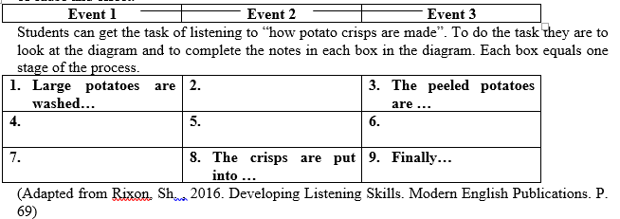

Slide 18
Classification diagram
A heard text can produce classification diagram. Usually it contains the rubrics for placing under them features and qualities of the phenomenon under study. E.g.
 | Living Beings
Animals ? | Feeding Breeding Breathing Moving Food-chain Internal circulation Senses Reaction | Plants ?

Slide 19
Reasoning map
A text can produce a reasoning map as shown below. A “reasoning map” can contain the definition of the problem, possible solutions to these problems, evaluation of consequences for every suggested solution and the preferred decision to be made.
(Adapted from Rixon, Sh. , 2016. Developing Listening Skills. Modern English Publications. P. 61)
 | Problem
Solution 1 | Solution 2 | Solution 3
Consequences | Consequences | Consequences
Preferred solution

Slide 20
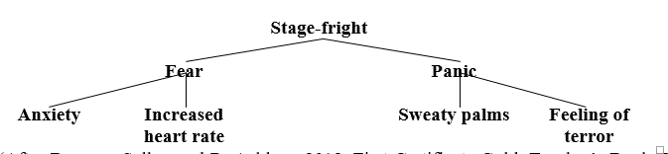
The function of the tree diagram
The function of the tree diagram is to store the information, which was heard from the spoken text and to show the relationship between the items. Most common example is the “family tree” (see below the tree diagram of the text about “stage-fright).

Slide 21
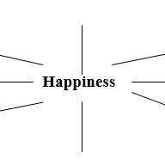
Mind map
If the text is built around one concept, to which other details are added (e.g. “What is happiness?”), then a suitable way to represent the contents can be a mind map.
It has one central concept in the middle and the surrounding notions or details linked to the central concept.

Slide 22
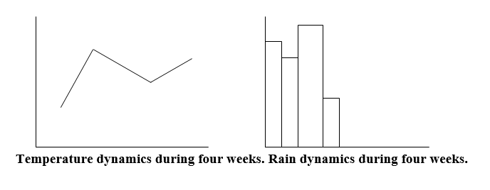
Graphs and bar charts
In order to keep mental record of the heard information about dynamic processes, the listeners can resort to graphs and bar charts. E.g. “temperature and rain dynamics” during a limited period of time as reported in the text for listening.

Slide 23
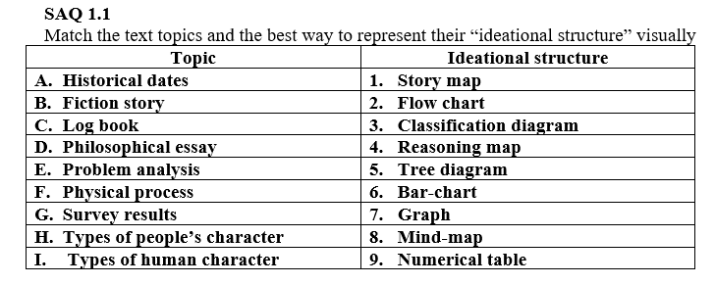
Visual image
Another way to keep the information from the heard text is by visual image. A possible task can be to label the parts of the car from the description you hear (the picture below is adapted from Underwood, M. 2017. Teaching Listening. Longman. P. 40)

Slide 24

Exploratory task 1.5
Ask one of the peers to read the text in the box for you. Tick off the items in the evaluation table that make for the difficulties of listening. Give recommendations of how to make listening easier.

Slide 25
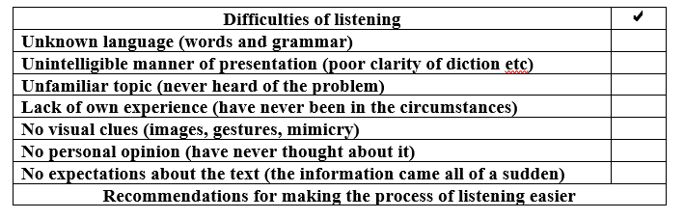

Slide 26
Stages of the listening process
The process of listening consists of three distinct stages.
In the first stage what we hear goes into the sensory store called “echoic memory” and is organised into meaningful units. At this stage the listener does not have much time to sort out the information.
The second stage is the processing of information by the “short-term memory”. This is also a brief stage lasting some seconds and the purpose of it is to blend the meaningful units together into one single unit of text comprehension. Once the message has been grasped, the exact wording is of no more importance and is obliterated from memory (some listeners can remember particular wording for a very long time though).
The third stage is the transfer of information to the “long-term memory” to be used either after listening as the “listener’s response” or later at the appropriate situation (Underwood, M. 2017. Teaching Listening. Longman. P. 2).

Slide 27
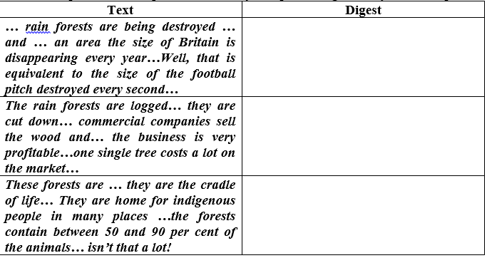
Exploratory task 1.6
Ask your peer to read a text from the left box for you (mask your text). S/he will make pauses at the text-dividing lines. You are to write in the space provided what you know at the moment about the contents of the text.
Each time in the new box you should rewrite the whole of your digest when there is a pause but you will have to compress more and more information within the same space size.
Compare the work of your “processing memory” with the peers.

Slide 28
Information processing
Understanding the language that we hear is a process, which can be called “inferential” i.e. we make inferences (assumptions) during listening.
Listening is not a straightforward matching of sounds to some exact meaning. A listener certainly performs an auditory analysis of the speech signals as they are produced by the speaker but the most essential part of the process is “meaning making”.
There is no direct correspondence between what is said and what is heard. Not everything can be perceived by the listener or interpreted exactly as was intended by the speaker.
Listeners perceive the language according to the probabilities they have made and the expectations they have generated about what they have heard (Rost, M.,2018. Listening in Language Learning. Longman. P. 33-34).
In the process of hearing a discourse, a listener usually signals comprehension and provides the “back-channelling” responses (e.g. aha , oh etc).
The role of the listener is to reconstruct and in many cases to create the meaning of the speaker’s message as encoded or possibly intended in the speech signals. This process can be shown by the flow chart:

Slide 29
Information processing
The view on the information processing remains as an encoding-decoding process. Yet, the growing theme in cognitive science is that people not just simply receive the knowledge, which is sent to them by the speaker.
People actively construct the knowledge that they hear and the process of listening in verbal communication is thus a construction and reconstruction process. The process of meaning construction/reconstruction is done through the inferences that the listener makes during the process of aural comprehension.
The process of making inferences includes estimating the sense of the words, constructing propositions (assumptions) about the text, assigning a general meaning to the heard text, making logical links in the heard text (connecting ideas in mind) and assuming a plausible (possible) intention of the speaker (Rost, M., 2018. Listening in Language Learning. Longman. P. 63).
In this sense, the process of aural comprehension is a collaborative process where listener collaborates with the speaker (Rost, M., 2018. Listening in Language Learning. Longman. P. 1-7).

Slide 30


Slide 31
Exploratory task 1.7
Text | Inference
Adventure sport is a growth area… and… more and more people want to test their nerves … they try hang-gliding, bungee jumping, ski-diving and other risky things…some people say though that car driving is much more risky… People enjoy boasting to their mates about how brave they are… Seeking sensation is a personality characteristic… it is not just excitement… Terror is wonderful!
Have your group peer to read the text from the left box for you (the text should be masked for the listeners. In the right box write the inference that you have made while listening. Your inference should not exceed 25 words. Share the results with the peers.

Slide 32
Listening roles
If the process of listening is understood as a collaborative discourse, then the participants in this process perform certain listening roles. Listening roles differ in the way the hearers get involved in the information that they hear. Some of them can be involved very actively in what they listen to, while others can be passive and inattentive listeners (After Rost, M.,1998. Listening in Language Learning. Longman. P.5)
Listeners’ roles are shown in the table:
Role | Features
Addressee Auditor Eavesdropper | A person who is spoken to directly and is to take the information fully A person who is spoken to directly but is not expected to have a full grasp of information A person not addressed directly and expected to possibly mishear something

Slide 33
Exploratory task 1.8
Ask your peer to read a text for you from the left box (the text should be masked for you).
Choose a listeners role (addressee, auditor or eavesdropper) but do not disclose your role to your peer.
Listen to the text and write in the right box what your have heard in accordance with your “role”.
Let your peer read your notes and identify your role.
Text | Notes
The storm started to develop … and the sea was … you know … swelling… the sky was greying over and … and winds got higher and higher … the sea was building up… it was now a rolling sea with mountainous waves… the sea was howling and rumbling…it was really incredible … blimey!

Slide 34
INPUT READING 2

Slide 35
Listening in teaching and learning
The process of teaching to listen is guided by principles.
  Principle 1. Teaching to listen as a communicative skill. This principle means that listening activities develop in the language learners the ability to listen to the language in the real world settings and to use this skill for receiving information from the heard discourse.
  Principle 2. Teaching to listen to authentic materials. The principle implies that the discourse for listening is expected to be either “authentic made”, i.e. produced by the native speakers for the purpose of natural communication or “authentic like” i.e. produced by native/non-native speakers for teaching purposes but having all the features of the natural English discourse.
  Principle 3. Teaching to listen as an integrated skill. Listening is very seldom done for the purpose of “listening only”. Usually people listen and speak, listen and write, listen and read. This is how listening is integrated with other communicative skills of reading, writing and speaking.

Slide 36
Exploratory task 2.1
Teaching to listen as a communicative skill | Teaching to listen to authentic language | Teaching to listen as an integrated skill
Give examples of the tasks that would meet the principles of teaching to listen

Slide 37
Listening as an active, extensive and intensive process.
Active listening is a serial process (done step by step) the purpose of which is to get a very accurate grasp of the information. As a result the listener can get the heard facts, summarise the information and remember it. Essentially, active listening is listening for details.
Extensive listening is a holistic process with the purpose of grasping the general meaning (the gist) of the heard language. The information that is received as a result of extensive listening is usually compressed and lacks details.
Extensive listening is listening for the gist.
Intensive listening is a parallel process of both listening and making assumptions about the heard discourse. “Intensive listening” is task driven and purposive, because listeners have a purpose of solving a certain cognitive problem. “Intensive listeners” can be judgmental and critical (have opinions and put to doubt what they hear).
Intensive listening is listening for inferences.

Slide 38
SAQ 2.1
Statements | T F D
Listening is taught for language build up in learners
Authentic texts make listening more difficult
Writing can come before or after a listening task
Active listening implies making inferences
Extensive listening is aimed at all sorts of small details
Intensive listening is a deep thought process
Memory matters most in listening
Mark the following statements as “true” T, “false” F or “debatable” D.

Slide 39
Activities for teaching listening.
Listening exercises include:
  making a tape-script
  repeated listening with wandering gaps in the played text
  ticking lexical items and grammar structures used in the text
  ticking what was mentioned and what was not mentioned (some items on the list may not have been used at all in the text)
  listening and doing
  Drawing
  Marking
  Dramatizing
  answering questions
  guessing from the text
  sequencing the order of speakers and/or events
  listening and matching (texts, graphs and pictures)
  completing gaps in the text (cloze procedure)
  completing the chart
  ticking in the list the paraphrased sentences with the same meaning as in the text, ticking true or false sentences,
  predicting the continuation of the text
  commenting on the text
  giving personal associations
  Reasoning
  picking up details
  remembering details
  transferring information to a table or to a graph

Slide 40
Exploratory task 2.2
Activities | Examples
Listening with wandering gaps | Playing the text several times each time muting the sound in a different place
Ticking lexical items
Listening and labelling
Guessing from the text
Listening and matching
Completing gaps in the text | Listen to the text and complete the gaps in the written version
Ticking true or false sentences
Transferring information to a table
Commenting on the text | Making learners compare what they knew before and after listening
Give your own examples to the following activities to teaching listening (some have been done for you)

Slide 41
Types of activities for teaching to listen
listen and do
listen and transfer and listen and infer.
“Listen-and-do” activities imply that the language learners listen to the language and while listening they perform commands, follow instructions, draw, tick off items on the list, sequence the text, match strip cartoons (picture stories), maps, plans, family trees, pictures with the heard texts etc.

Slide 42
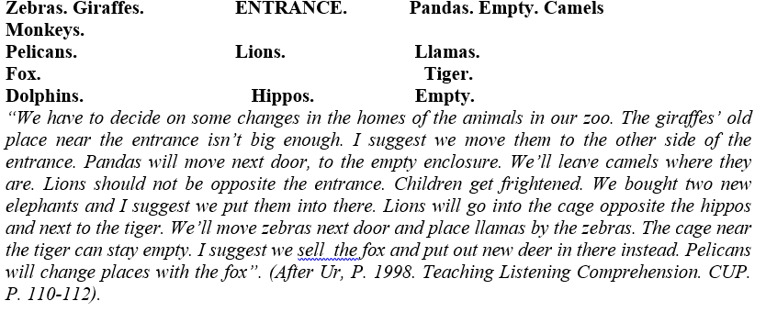
Exploratory task 2.3
Learners are given a recorded passage describing changes in the zoo layout. Introduce the necessary changes in the sketch of the animals in the zoo and reflect on the difficulties in performing this task.

Slide 43
“LISTEN-AND-TRANSFER” ACTIVITIES MEAN THAT WHILE LISTENING TO THE LANGUAGE, THE STUDENTS TRANSFER INFORMATION TO TABLES, DIAGRAMS, GRAPHS, DRAWINGS, NOTES ETC

Slide 44

Exploratory task 2.4
Listen to the announcements at London-Paddington. Complete the chart. Reflect on the difficulties to perform the task.

Slide 45
“LISTEN-AND-INFER” ACTIVITIES ARE BASED ON THE TASKS TO INTERPRET SITUATIONS, MOODS AND ATTITUDES IN THE HEARD DISCOURSE, DRAW CONCLUSIONS, MAKE ASSUMPTIONS AND HAVE JUDGEMENTS, E.G. OF THE “TRUE – FALSE” TYPE.

Slide 46
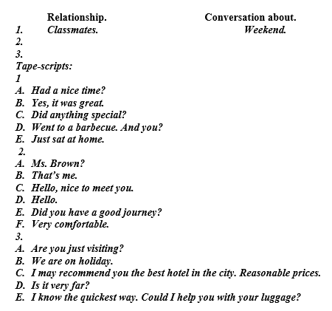
Exploratory task 2.5
“Listen to the conversations (tape-scripts are given below). Write the relationship between the speakers and what they are talking about. The first one has been done for you”. Reflect on the difficulties you experienced in performing the task.

Slide 47
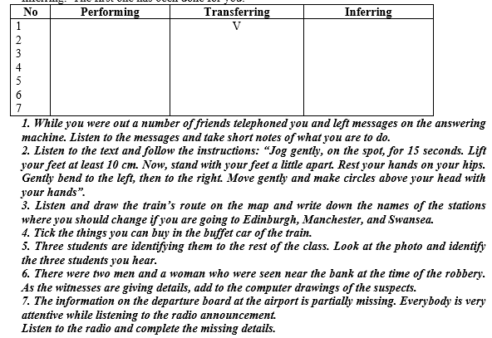
Exploratory task 2.6
Refer the following activities to one of the types:
A/ Performing.
B/ Transferring.
C/ Inferring.
The first one has been done for you.

Slide 48
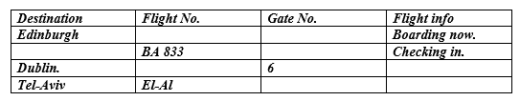

Slide 49
Listening to monologues and dialogues.
A monologue (one speaker language performance) can be of the “spoken” and “written” type. Listening to spoken and written monologues makes a difference.
Written texts have longer sentences. They are more organised into meaningful units thanks to syntax, intonation and rhythm. Information in “written” monologues is more concise.
Oral monologues are more spontaneous and “word-loose”. Their information is ‘redundant”, i.e. many details are repeated and reworded. Compared to the economical language use in written texts, oral discourse is a “language explosion”.
Oral discourse is made redundant because the speaker monitors the process of the message intake by the listener through eye contact and comprehension checks.

Slide 50
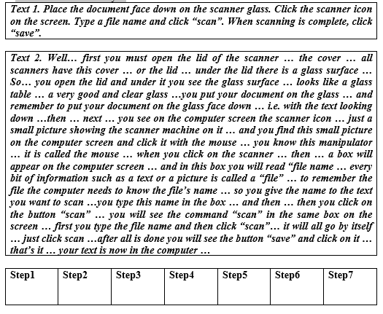
Exploratory task 2.7
Listen to the description of how to use a “scanner” (a technical gadget to turn a printed text into an electronic version that is stored in the computer memory).
One explanation will be done in the “written discourse mode” and the other will be delivered to you in the “oral discourse mode” (ask your peer to read both texts to you).
After having listened to each version, describe in your own words the steps you must take for using the scanner. Which text was easier to comprehend and to do the task? Why?

Slide 51
Typical features of teaching to listen to a dialogue
Dialogues (language performance of two or more interacting participants) can be scripted or spontaneous.
While listening to a dialogue, the listeners can be concerned with
who is speaking (gender, occupation, age)
how many are speaking
how they are speaking (emotional attitudes)
what they are speaking about and which is the message they are actually communicating
why they are speaking (what is the information gap between them)

Slide 52
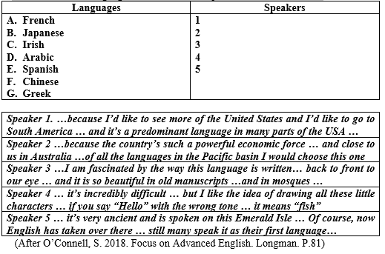
Exploratory task 2.8
Ask your peer to read the given texts for you. Do the listening activity and indicate what cues did you actually listen to in order to cope with the task. “Five people were talking together about the languages that they would like to study. Match the speakers in the group dialogue 1-5 that you will hear with the languages listed A-G. Two options will not be needed

Slide 53
factors that make listening difficult.
Difficulty can be caused by:
  the unknown words
  complex and strange grammar structures
  strange cultural context
  uncertain message
  too many inessential details
  lack of essential details (sometimes a tiny detail is a cure to comprehending the whole text)
  tempo of speech
  interfering noises.

Slide 54
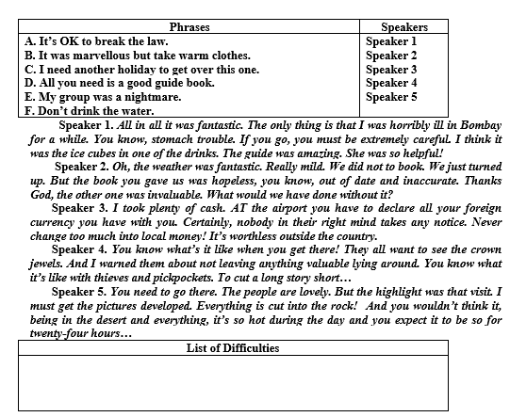
Exploratory task 2.9
Do the following task and report on the difficulties you have experienced as learners. Work in small groups. “You are going to hear five different women talk about travelling. Match the phrases (A-F) with Speakers 1-5. There is one sentence which you do not need to use”.

Slide 55
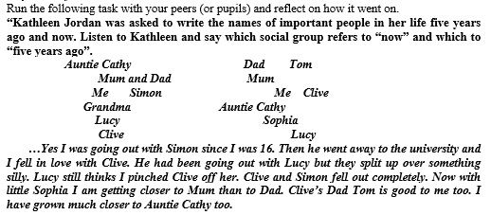
Exploratory task 2.10
Run the following task with your peers (or pupils) and reflect on how it went on.

Slide 56
Pre-listening, while-listening and post-listening activities
Pre-listening activities are preparations for listening. Pre-listening work can consist of a whole range of tasks including the teacher giving background information, the students reading something relevant to listening, the students looking at the pictures and eliciting from them, the students discussing a topic situation, answering questions, writing what they know about the topic of listening, considering what language they might need to understand the oral text, getting full understanding of how they will perform the listening task (Underwood, M. 2017.Teaching Listening. Longman. P. 31-37).
While-listening activities are what students do during listening to the text. The purpose of while-listening activities is to help learners develop the skill of eliciting messages from the heard text. While listening the students are to look at the pictures of the traffic and to put a cross where the rules have been broken Other tasks can be: Listen to the text and decide which pictures represent the story. Arrange the pictures in the correct order according to the heard text. Listen to the text and complete the chart. Listen to the text and tick off from the lists the items that have not been mentioned. Listen to the text and mark the sentences that follow the text as True or False. Listen to the text and complete the gaps in the text. Listen to the text and correct the printed version (Underwood, M. 2017.Teaching Listening. Longman. P.49-69).
Post-listening activities are done after the process of listening is completed. The most common form is to check comprehension. Another purpose of post-listening tasks is to know why some students failed to comprehend the heard text and missed essential points of information. Yet another purpose is to expand on the topic or on the language of the heard text. (Underwood, M. 2017.Teaching Listening. Longman. P.74-86).

Slide 57
Exploratory task 2.11
Jig-saw listening is an activity, in which the learners are divided into small groups and each group listens to a different text, all the texts being on the same topic. Later the groups exchange information to pool together a complete picture (After Rixon, Sh., 1986. Developing Listening Skills. Modern English Publications. P.120).

Slide 58
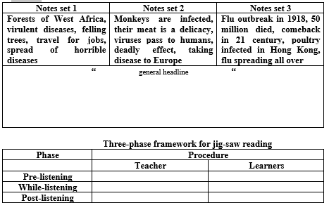
Exploratory task 2.11
Analyse the following “jig-saw” listening activity and arrange it in the three-phase framework in the space provided: Work in pairs. Let your partner speak from one of the notes set provided. Listen to the discourse and take your own notes. Share your notes with the peers who listened to other pieces. Write a single text and give it a title.

Slide 59
MICRO-TEACHING TASK
DEVELOP A LESSON MATERIAL BASED ON THE ACTIVITY GIVEN BELOW. RUN A ‘THREE-PHASE FRAMEWORK” LESSON.

Slide 60
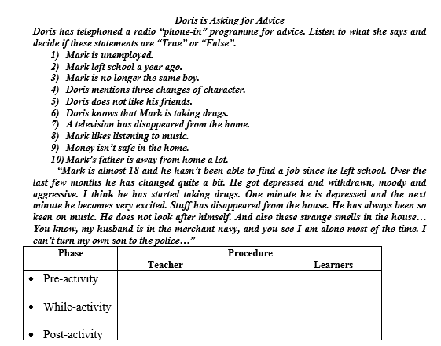

Slide 61
Integrated task
Do
Do the integrated task according to the following plan:
Give
Give a clear teaching goal
Describe
Describe your teaching situation (whom you are going to teach listening)
Give
Give a theoretical rationale for your teaching technique
Present
Present clearly your teaching technique in the three-phase framework
Describe
Describe the procedure of teaching and give transcripts of the process
Reflect on
Reflect on how the technique went on in teaching
Draw
Draw conclusions

