Slide 1



Teaching to
Speak
Выполнили: студентки группы АНБ-511
Микаелян В., Чуева О., Налимова Ю.

Slide 2
The aim of this module
To make you think about speaking as a skill
To present a variety of techniques to teach speaking
To reflect upon the ways of teaching to speak

Slide 3
What do you have to do in this unit?
Warming up discussions
Input reading
Exploratory and self-exploratory tasks
Micro-teaching with observation
Integrated task

Slide 4
Input reading 1
Warming-up discussion 1.1
Complete the grid below indicating the real world situations, in which it is necessary to speak.
Situations for
Speaking

Slide 5
Speaking as a skill
Speaking is a skill on oral communication consisting in sending an oral message (Bygate, M. 1987. Speaking. OUP). Speaking is an integral part of oral conversation. There are certain genres of oral conversation i.e. typical types of oral performances in typical settings with the typical and highly predictable features (genres of oral conversation can be found in R.Carter and M.McCarthy. Exploring Spoken English. CUP. 2017).

Slide 6
Among the genres of speaking are description (telling the details to an active listener), narration (telling the development of events to an active listener), reasoning (telling one’s train of thought to an active listener), identification (talking about one's likes and dislikes) Other genres are language-in-action (people doing things and talking), comment (opinions and angles of view), service encounters (buying and selling of goods and services), debate and argument (seeking a solution and pursuing one’s point), learning (use of language in learning) and decision-making (people working towards decision). The ability to perform these genres is a proof of the skill level. This is how the language is used in everyday life.

Slide 7
Exploratory task 1.1
Study the list of speaking genres, indicate real world situations where these genres can occur. Some examples have been given to you.
Genre | Situation
Description
Narration | Telling a tale to a child
Reasoning
Identification
Language-in –action
Comment
Service encounters
Debate and argument
Learning
Decision making

Slide 8
Exploratory task 1.2
In the process of communication a speaker performs the necessary communicative functions (information request and providing information, saying rituals of greeting and others, expressing imagery and feelings, controlling other people’s behavior). A speaker can use conventional phrases without much meaning in them (e.g. How are you?). Speakers can use plain or metaphorical language (“If you don’t obey, you’ll get in the neck!) to be more expressive.

Slide 9
Check your ability to perform the following functions
Oral functions | Language samples
Providing information Confirmation Denial Promise Rhetorical question Description Narration Reasoning
Ritualizing Greeting Farewell Congratulation Invitation Condolence
Controlling other people’s behavior Approval Disapproval Blaming Apology Warming Threat

Slide 10
Exploratory task 1.3
Study your own style of oral speech. Mark the following statements as “true” or “false” as referring to yourself. Describe your communication style. Find among your peers a person with the same oral style as yourself.

Slide 11
Statements | T F
I am a blunt person I criticize people I rarely admit I am wrong I can gossip about a mutual friend I compliment people I use rude language at least sometimes I like to talk about myself I am a good listener I push forward my ideas I talk a lot I don't mind talking about a situation where I was embarrassed, humiliated and so on

Slide 12
Planning and producing oral speech
The process of speaking starts before the actual moment when the articulation starts. A great deal of planning in the process of speech production is done during speech hesitation pauses. Hesitation pauses occur mostly before most important parts of utterance where it is necessary to think hard of what to say (Goldman-Eisler, F. cited in Aitchison, J.2018. The Articulate Mammal. An Introduction to Psycholinguistics. L. N.Y. P. 239). Speakers do not deal with one meaningful chunk of speech at a time. Instead, speakers begin planning the next meaningful clause while uttering the present one.

Slide 13
Oral speech is addressed to the audience. It is time-bound, spontaneous, interactive, exists in real time, is accompanied by non-verbal features, gives an opportunity to rethink and repair, employs phonetic means such as timbre (Aitchison, J.2015. The Articulate Mammal. An Introduction to Psycholinguistics. L. N.Y. P. 240-251). This makes oral speech different from written language.

Slide 14
Exploratory task 1.4
How will you repair the following conversation making it more organized for writing? Who are the participants and what are they talking about?
Original utterance | Repaired version
What age did you start it? From ten to eleven And gave up? About a year ago Why? It’s all like … all the posters you see about…and you know … it gives you … lung cancer … and all that … How did you do it? Just gradually … went off them … stopped buying my own … started cadging them first …then by the time …just give … gave them up after a while …
(Tip: This is an interview with a fifteen year old who has given up smoking)

Slide 15
Oral speech produces a discourse. Oral “discourse” is a continuous stretch of spoken language acquiring its meaning in the context and understood only if we know the speakers’ reality (Nunan, D. 2017. Introducing Discourse Analysis. Penguin Books).
Discourse analysis produces distinction between interactional and transactional function of the language. The information-transferring function is called transactional. Transactional function of the language is message oriented. The purpose is to get things done. Examples are science reports, news stories, eye witness accounts to the police, a talk between a patient and a doctor etc. In all the cases it is necessary to extract the salient details, to sequence and to present them to the listener or to the audience. This function is performed for “bringing the message across” and for “getting things done”.

Slide 16
Other types of conversation are different. People chat with each other for pleasure. They talk feeling comfortable and friendly towards each other. This function of the language is called interactional. Interactional function of the language is listener-oriented. The purpose is to “oil the wheels of communication”. These talks are friendly dialogues (Brown, G and G.Yule.2017. Teaching the Spoken Language. CUP. P. 10-39)

Slide 17
Exploratory task 1.5
Match the following pieces of discourse with the types of “transactional” or “interactional” language.
Discourse samples | Types of discourse
… and with the acting in the film … you know … it really works well … it’s a great script to start with … and all the jokes come through … very entertaining … one thing that I like about my age is that you have a sense of proportion …less and less of these highs and lows as the teenagers have … Young prodigies are of course not confined to music … take sports for instances such as chess or athletics …many of them miss a lot in their general education … their parents’ expectations put them under stress as well … … well … you can have lots of emotions … lots of love … and you can keep in your emotions and would let it out in little bits … it’s all in your fancy and the more fancy you have the more romantic you are … …in fact it’s been estimated that up to 40% of all drugs prescribed in the USA are derived from rainforest resources. These resources have been used for centuries … | Transactional discourse Interactional discourse

Slide 18
Conversational discourse has certain typical features (Carter, R., and M. McCarthy, 1995. Language as Discourse: Perspectives for Language Teaching. London:Longman): back-channels (Uhum), binomials (Hit or miss), discourse markers (well… I mean…), ellipsis (Think so. Seen my glasses anywhere? Want another drink? Know where to go? ), fixed expressions (A good time was had by all), fronting (To this man I dedicated…).

Slide 19
Other features are heads (That chap, he is…), hedges (He was… kind of …sort of), tags (She is nice. She is), tail (She is nice. Clare), modality (He could, probably…), vague language (Can you get me a sandwich or something?).
Conversational discourse uses sound imitating words e.g. The door went "bang", The flames went "Whoosh!" etc.
English conversational discourse often uses “understatement”, i.e. putting ideas in a milder form.

Slide 20
Exploratory task 1.6
In the space provided write the devices of the conversational discourse found
Discourse samples | Devices
1. It’s depressing and … I mean … it can even go worse
2. And it’s to this purpose that he dedicated his entire life
3. …absolutely crazy … just crazy to behave like that …
4. I do feel a sense of responsibility … kind of feeling … that is … sort of … new to me
5. He is the sort of driver that picks up speeding tickets and all that, you know
6. And the moment I touched it went “whoosh!” and was gone
7. He is not quite well mentally, sorry to say it I mean it’s a real problem

Slide 21
Speaking as a skill depends much on the communication strategies (decisions on how to achieve the communicative goal). The list of communication strategies includes: approximation, paraphrase, word-coinage, negotiation of meaning, time-creating devices (hmm), elliptical language, body-language, mime, changing the subject (Mc.Donough, S. 1995. Strategy and Skill in Learning a Foreign Language. London. Bialystock, E. 2220. Communication Strategies. Oxford: Blackwell).

Slide 22
Exploratory task 1.7
Analyze the following conversation: (A man, woman and child are having dinner in a South Philadelphia diner). Answer “questions for analysis in the right column”
Conversation | Questions for analysis
Waitress: (to woman:) what're ya havin', dear ? Woman: I'll have the prime rib with baked potato. Waitress: How d'ya like the steak done? Woman: Medium rare. Waitress: On your salad? Woman: Blue cheese. Waitress: (to boy:) ok how 'bout you, sweetheart? Child: I'll have a cheeseburger with fries and a coke. Waitress: O—kay! (to man:) how `bout you, sir? Man: I'll have the spaghetti and meatballs. Waitress: On your salad? Man: Ranch. Waitress: To drink? Man: A glass of that .. you know… as usual. Waitress: O—kaaay, we'll get started on that. | What kinds of `standard' and `non-standard' speech is exhibited in the conversation? What kinds of address forms are used by the various participants in this conversation? In which order does the server address the others, and why? Why do some of the participants never use any address forms; do you see this as impoliteness, or a lack of deference on their part? What communication strategies are used by the participants?

Slide 23
In order to be successful in oral communication, one needs communication skills. Essential among them are “social skills” or skills in co-operating with people. Social skills are also known as co-operative skills i.e. an ability to communicate effectively in a clear and laconic way.

Slide 24

Exploratory task 1.14
Look at the picture on the left and give your partner commands to enable him/her to draw the same picture without seeing it. You are allowed to use the words such as “a straight line’, “a curve”, “on top”, “down the middle” etc.

Slide 25
Input reading 2
Teaching to speak
Generally speaking there are three major principles (guiding rules) of teaching to speak. Teaching to speak is done through motivated speaking for meaning. Teaching to speak is done through speaking for information. Teaching to speak is done through speaking for interaction. (Littlewood, W. 1981. Communicative Language Teaching: an Introduction. CUP).

Slide 26
Communicative exercises in teaching to speak are organized as information transfer (extracting certain pieces of information from a non-verbal form e.g. a table, a graph, a map etc). Another type of exercises is information gap (information is conveyed from the person who possesses it to the one who lacks it). Information gap can take the form of a jigsaw (each learner has only some information, which is part of the whole and is to be brought together by means of oral communication) (Johnson, K. 2012. Five principles in a "communicative exercise type". Communicative Syllabus Design and Methodology. Prentice Hall. P. 163-175).

Slide 27
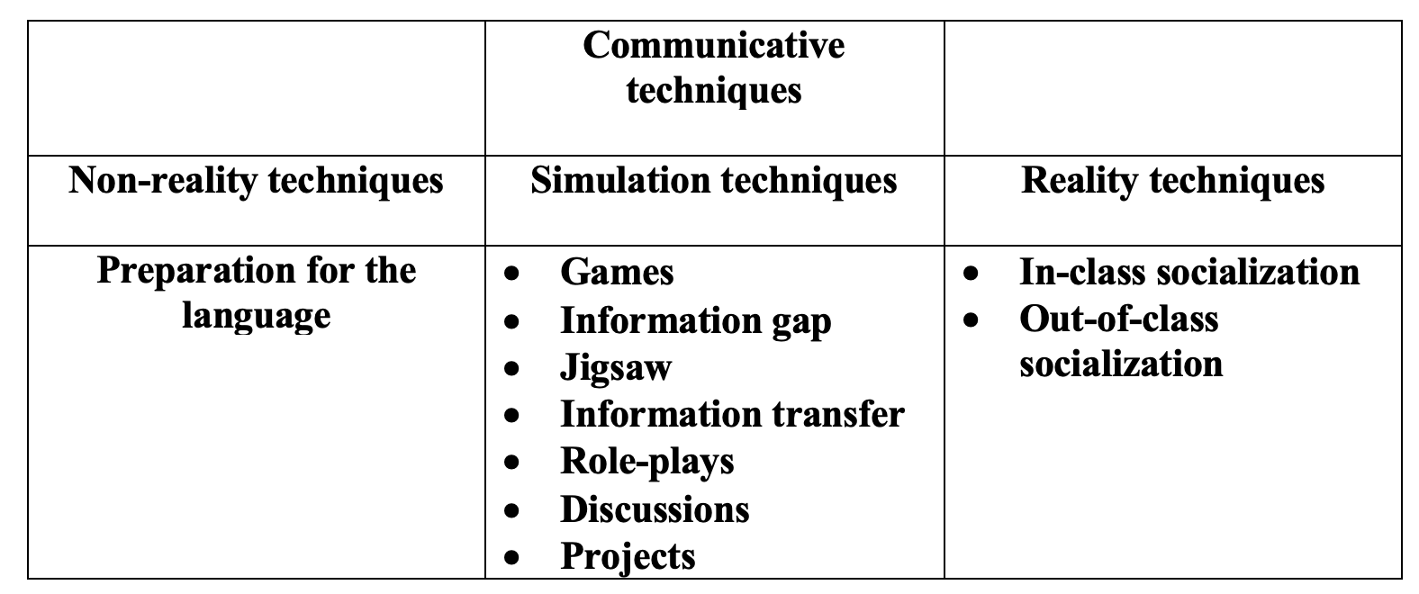
Communicative techniques can be isolated as shown below:

Slide 28
Communicative games have a task, rules, participants, competition, winners (examples of communicative games can be found in Hadfield, J. 2017. Advanced Communicative Games. Nelson. Wright, A., M. Betteridge and M. Buckby. 2014. Games for Language Learning. CUP). Games can be classified as follows:
Information gap games (the winner is the first who compiles together all the necessary information from other participants)
Matching, contrasting and comparing games (fitting, exchanging, collating, spotting differences)
Sequencing games (the winner is the first who does the correct sequencing),
Guessing games (the winner is the first who does the correct guess, e.g. "Who am I?", wearing a sticky label on one's forehead and asking questions about oneself)
Community games (popular past-time games like “crosswords”, “dominos” or “bingo” with a language focus in mind),
Attention games (the winner is the one who is most attentive in performing the tasks),
Memory games (the winner is the one whose memory works best),
General knowledge games (the winner is the best one at general knowledge quizzes
Board games (a game organized between couples or groups of partners with a playing board, e.g. a grid and dice with a task in each box of the grid and the order of tasks determined by casting the dice)

Slide 29
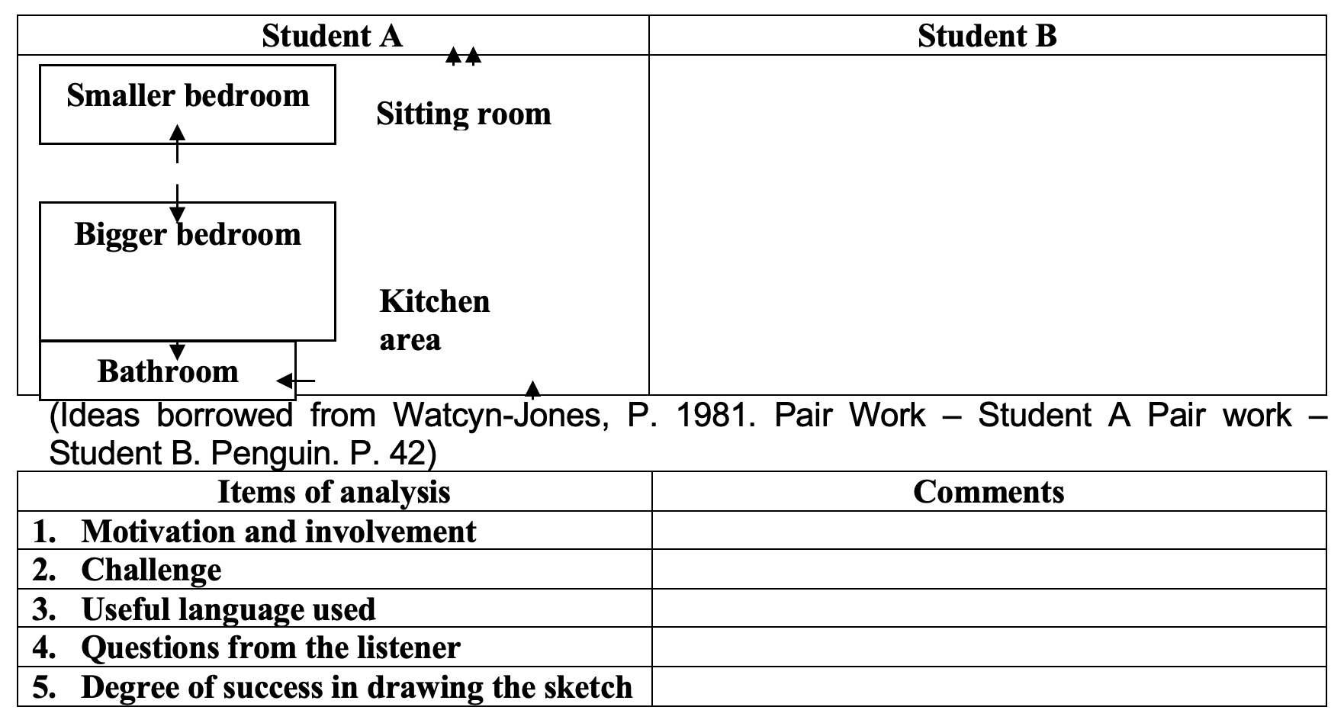
Exploratory task 2.1
Run this typical “information-gap” activity and reflect on the procedure. Student A is given the plan of an apartment. Student B has a blank sheet. Student A is to describe the plan of the apartment to student B without showing the sketch to him. Student B can ask comprehension-check questions. After the students have finished the task, the drawings are compared.

Slide 30
Exploratory task 2.2
Run the “jig-saw” activity to practice speaking. Student A has a text, which is the beginning of the text for student B. The two texts complement each other. Without showing the texts to each the learners ask each other “Yes-No” questions (comprehension-check questions are allowed too e.g. “Do you mean to say that …?) and pool the whole information together. Reflect on the procedure.

Slide 31
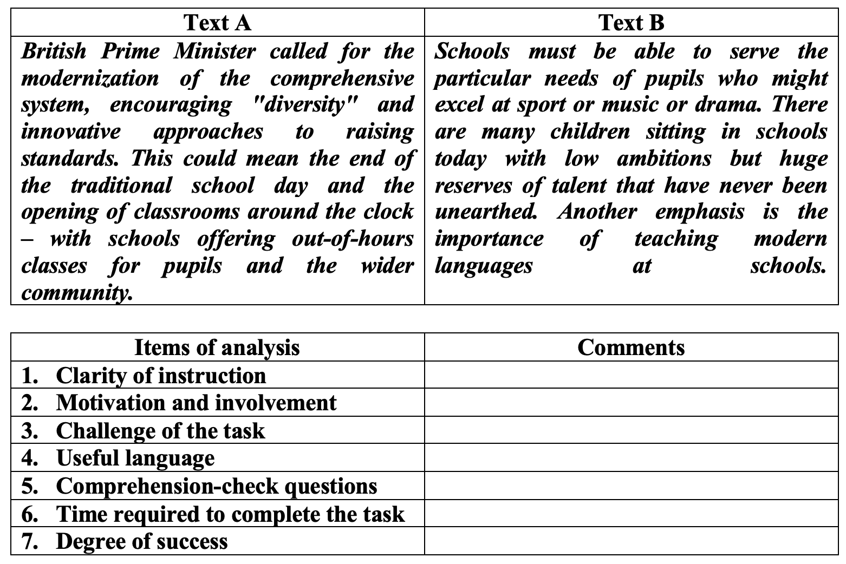

Slide 32
Simulation activities
Simulation activities are replicating reality for language study purposes. Simulation can take the form of role-play and problem solving. Role-plays can be based on roles and scenarios (Porter Ladousse, G. 1987. Role Play. OUP). Discussions are usually based on problems and opinions (Ur, P. 2011. Discussions that Work. CUP).

Slide 33
Role-play can be described with at least four features: closeness (a plot can be very close to one's own experience or distant), situation (a situation can be very typical for every day or unlikely), realism (the circumstances can be realistic or imaginary), personality (the characters of the role-play can resemble the participants themselves or be alien to them) (After Byrne, D. 2016. Teaching Oral English. Longman. P. 117-118)

Slide 34
Role-play can be controlled (the participants are responsible for the language they use), semi-controlled (participants are partly expected to use the prescribed language), free (participants are responsible for the message not for the prescribed language, small-scale (lasting for a lesson or less) and large-scale (lasting for more than a lesson or perhaps for the whole term).

Slide 35
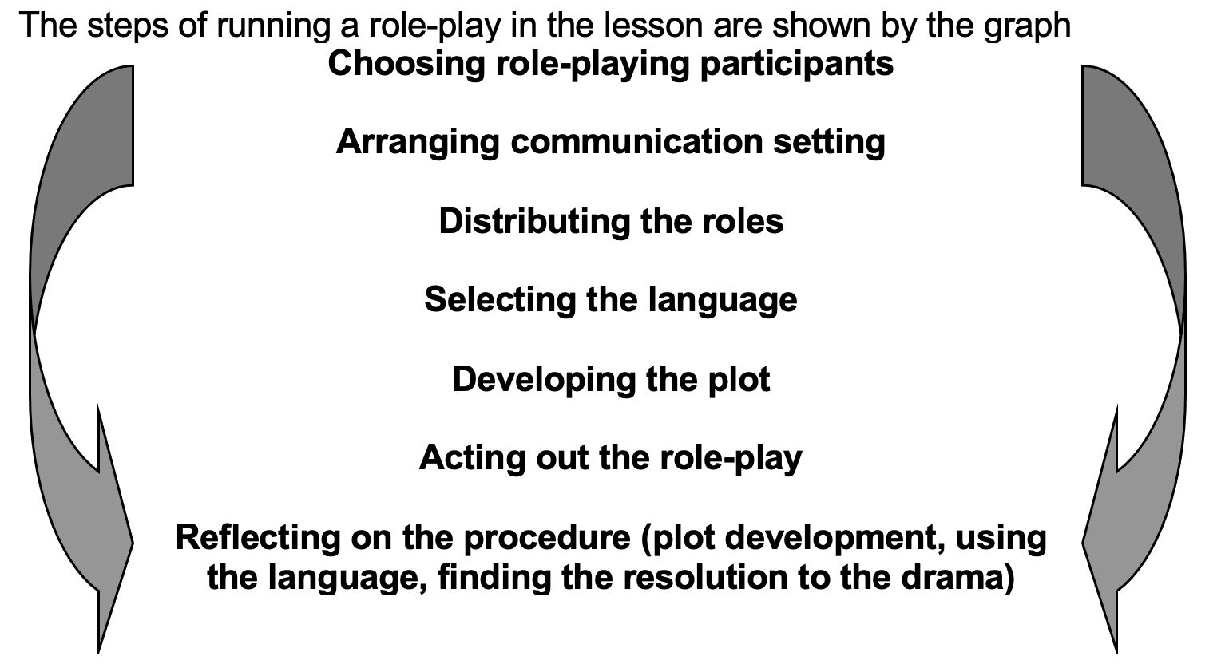

Slide 36
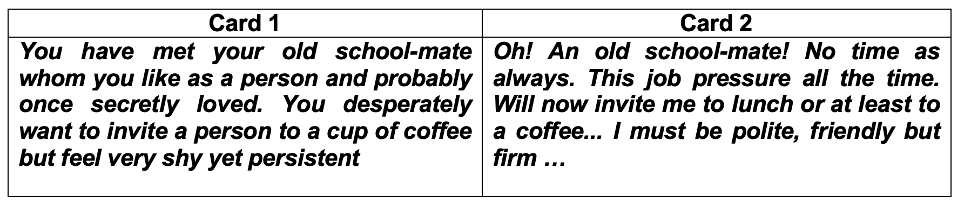
Exploratory task 2.3
The task is done in a group of three. This role-play has a “hidden agenda”, i.e. the participants communicate in order to achieve a goal, which they never make explicit. Two participants act out a role-play according to the role-cards. The third participant is an observer and is to infer the “hidden agenda” from the overheard conversation (this participant should not see the role-cards!)

Slide 37
Discussion is a simulation of reality for study purposes with problem-raising task, co-operating or challenging viewpoints of participants, polarization of opinions, decision making and problem resolution.
Discussion can be organized as pyramid discussion. It means that a problem task is given to pairs of students. Once a pair has solved the problem, two pairs are put together to compare answers and to agree a joint solution to the problem. Then larger groups continue to discuss the problem and to work out a single solution. Finally a single variant for the whole of the class is worked out (Jordan, R. 1990. "Pyramid discussion. ELTJ 44/1. P. 48).

Slide 38
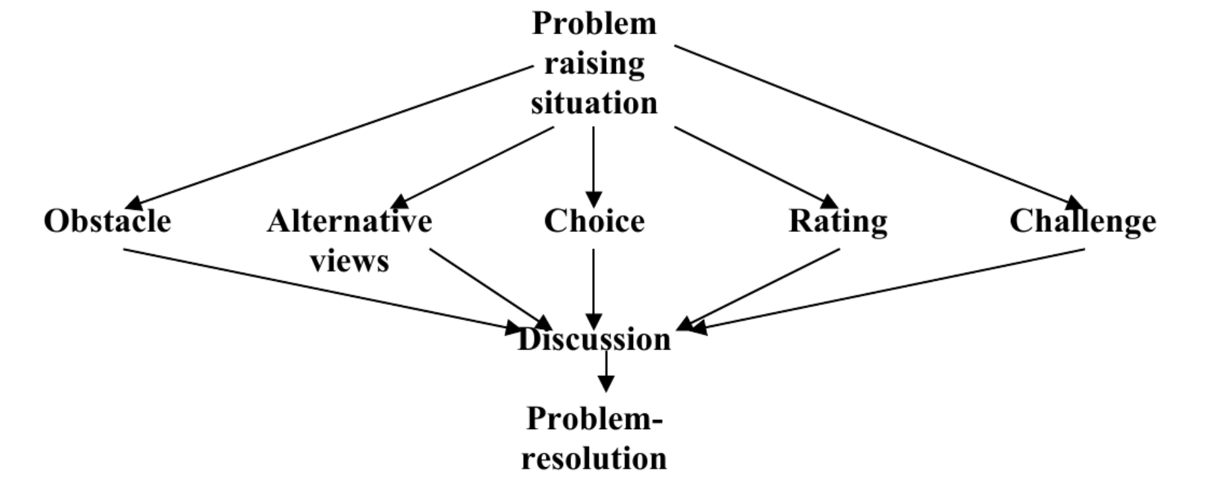

Slide 39
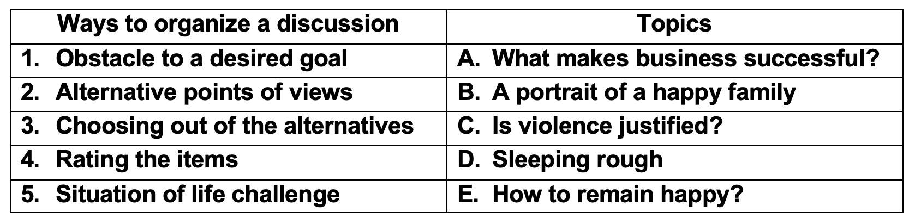
SAQ 2.1
Match the ways to set up a problem for discussion with the topics for discussion

Slide 40
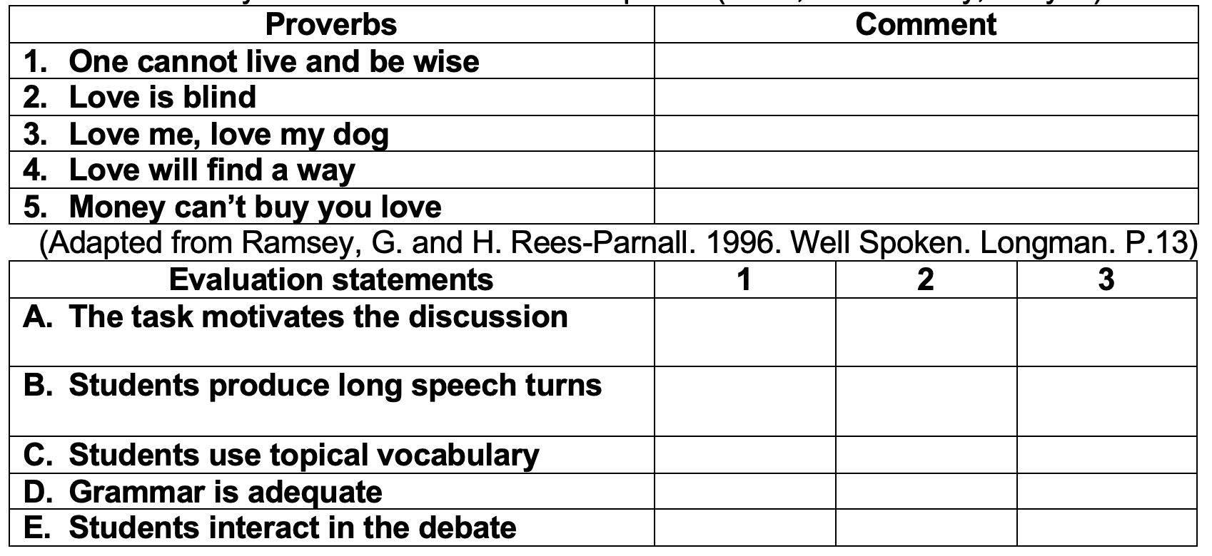
Exploratory task 2.4
Students comment on the following proverbs and sayings that have the word “love”. After the activity the evaluation form is completed (1- no, 2 – in a way, 3 – yes)

Slide 41
Exploratory task 2.5
The participants choose from the first three cards. They read the opinions, comment on them, debate with each other and go to the next card as prompted. At the end the participants discover whether they know American law on wearing seat belts in the cars or not
1 Drivers must wear safety belts Go to card 4 | 2 Drivers may wish to wear safety belts Go to card 5 | 3 Drivers may not wear safety belts Go to card 6
4 Drivers must take care of their and passengers’ lives Go to card 7 | 5 Drivers can decide on whether to protect their lives with belts or not Go to cart 8 | 6 Drivers are not obliged to protect their own and passengers’ lives Go to card 9
7 Police will ticket the driver without a safety belt Go to card 10 | 8 The police will only stop the driver for speeding up Go to card 11 | 9 A driver can’t be punished for not wearing safety belts Go to card 12
10 Ticketing drivers for not wearing safety belts is against USA law Go to card 13 | 11 If the car is pulled over, the driver can be ticketed for no safety belt Go to card 14 | 12 If the car is pulled over, the driver is ticketed for speeding up only Go to card 15
13 You should know USA law better Read the driving code | 14 You know USA driving code Safe ride! | 15 You should know USA law better Read the driving code

Slide 42
Evaluation form
Presentation
Presentation is a structured individual or group talk made for the audience. Presentation is done in the following stages: introducing the subject and the team, performing the scenario of the presentation, receiving feedback. There are certain presentation techniques to keep the audience interested during the performance
Items of evaluation | Yes or No
Language goal (what language is to be learned) is clear
Instruction to the activity is concrete
Language of the activity is comprehensible
The procedure is motivating and interesting
The activity is mind-broadening
The activity fits well within the time limits
I will use this type of running discussions with my learners

Slide 44
Exploratory task 2.6
Choose the subject of your own presentation and give examples of how you are going to keep the audience interested
It is often useful to give the learners the cues, from which they can speak. Types of cues in a variety of speaking tasks include cards, notes, table of data and graphs, mind-maps, plans.
Techniques | Examples
Ruin expectations of the audience use examples Show illustrations Ask the audience for feed-back Encourage the audience to think Contrast views Modulate your voice Highlight the message Close down effectively

Slide 45
Exploratory task 2.7
Speak from the following cues and say which cue you liked most of all and why.
Cue 1
Cue 2
Cue 3
You want to sell the old computer that is actually in good condition. Sound enthusiastic. Describe what successes you have achieved working with this PC. Describe how nice this small screen is. The keyboard thought old is very soft. The computer memory is limited but it is much bigger than human memory. The machine is slow but you have time to stop and think instead etc
You want to speak about gender differences. Here are your notes: women live longer, more often unemployed, less often become prisoners, marry younger, less likely to die of heart attacks, smoke a lot, more men in politics, pilots, miners, soldiers, priests (now changing), less men beauticians and nurses
You want to speak about pay-and-prestige of different professions. Use the graph (you can question the graph if necessary): High e b d Prestige a c Low High Pay a teachers, b doctors, c officers, d – lowers, e – bankers

Slide 46
Cue 4
You will speak about life in the village using the mind map: Solitude Informal clothing Life in the village Lack of amenities Beauty of nature
Cue 5
You will speak about advertisements on TV according to the plan: Give an introductory phrase Describe an ad that you like Describe an ad that you dislike What do you find irritating about the ads on TV? Make suggestions

Slide 47
Exploratory task 2.8
Consider the following techniques to develop social skills in learners and say what social skills can be developed with their help:
Taking part in oral communication is not guaranteed against cognitive problems. There are ways of resolving the difficulties that the learners can experience during the speaking tasks
Techniques | Social skills
Strip stories (telling a story by saying an episode by each student in turn) Viewing through other people's eyes (saying what others might think and feel about the subject) Rally (practicing public addresses) Conflict resolution (practicing the way to intervene in conflict situations) Friendly chat

Slide 48
Exploratory task 2.9
Match the learner difficulties and the “remedies” for them
Learner difficulties | Remedy
Can't finish the talk | Introduce competition
Can't start the talk | Offer the beginning of the talk
Cheat in games | Give language chunks
Lack ideas | Focus on turn-taking
Lack enthusiasm | Set the time limits
Lack language | Focus on the rules of the game
Losing thread | Highlight the goal
Lack interaction | Create an information gap
Switch code | Introduce fines for using L1
Time abuse | Brainstorm in small groups

Slide 49
Exploratory task 2.10
Refer the following tasks to either pre-speaking, while-speaking or post-speaking activities. (The learners are shown a photo, on which a man is ready to jump down from the roof of a high-rising building)
Task | Phase
A/ What words and phrases have been used to describe what the man felt? B/ Write a note that the man had left before deciding to take his own life C/ Why do you think the man is standing on the edge of the roof? (the photo is demonstrated to the learners) D/ Why do you think the man is thrusting himself down? (the photo is demonstrated to the learners) E/ Do you think the man might have a sense of adventure? F/ What type of character one needs to jump down from the top of the high-rising building? G/ Discuss in small groups the reasons why people decide on taking their own lives and produce a list or reasons. H/ Share the results of discussion with other small groups. | Pre-speaking While-speaking Post-speaking

Slide 50
Framework for the description of the activity:
Phase | Procedure
 | Teacher | Learners
Pre- activity While-activity Post-activity

Slide 51
Integrated task (to be done in the classroom or with the peers)
Clarify your goal of teaching
Describe your teaching situation
Give details of the activity to teach speaking
Provide transcripts of how the activity went on
Comment on the teaching procedure
Suggest ways to improve the teaching process
Draw conclusions

