Slide 1

Teaching Vocabulary
Выполнили: Ребриш В, Чукалина В.
АНБ-512

Slide 2

The aim of this unit
· To take a view on the “vocabulary-in-mind” phenomenon
· To make you think about the process of vocabulary learning
· To reflect upon the activities for teaching vocabulary

Slide 3


Mental lexicon
Mental lexicon is “vocabulary in mind".
It consists of the smallest independent meaningful units of speech.These units of speech are called words. The words have word-forms and meanings assigned to them. Words in mental lexicon create lexical networks.
‹#›

Slide 4
Once activated a lexical item stimulates other associated lexical items and this causes activation of a bigger network. To access mental lexicon an idea has to be mapped onto meaning and form that are stored in our memory.
‹#›

Slide 5
Retrieval of words from memory is done through the activation of mental lexicon. Activation is caused by attempts to map an idea onto the words in memory.
Sometimes meaning can’t be mapped onto the words and this causes the "tip-of-the-tongue phenomenon" when the meaning needs to be expressed but the form can't be retrieved from memory.
‹#›

Slide 6
Word comprehension can run into a problem because of the vague lexical meaning, allusions and references, symbolic, metaphorical and idiomatic use of words.
One of the means to overcome lexical ambiguity is getting the cues from the context, background knowledge, social culture and the situation setting.
‹#›

Slide 7
Word use can be hampered by the absence of the necessary word in processing memory or in the mental storage.
In this case language users resort to lexical strategies such as circumlocution (putting the idea in a different way), word coinage (creating a non-existent word) and derivation (forming a word from the one that is known to the language user).
Another strategy is using the gestures and mimic.
‹#›

Slide 8

The use of words in both speech production and comprehension is the result of the cognitive processes.It starts with the perception of the situation that makes it necessary to look for a word in the “master-file”(the main storage of words).
‹#›

Slide 9
A process of cognition produces the meaning, that a person is willing to communicate in the circumstances. It is necessary to consider the “word pragmatics”, i.e. to see that word does not elicit an unwanted reaction from other participants in the communication.
Using a word means recognizing certain grammar obligations. Finally, the word is accessed in memory and is produced either in the graphical or oral form.
‹#›

Slide 10
Interesting data on mental lexicon has come from cross-cultural studies in colour categories. Some cultures have terms for a wide variety of colours. In Western Europe there is diversity from “magenta” to “sky-blue”.
Other cultures have very few terms. "Blue" and "greed" tend to become merged together with increasing proximity to the equator. In extreme cases one word is used to name "black", "blue" and "green". In Papua New Guinea there are only two colour terms for black and white to show all the diversity of colours around.
‹#›

Slide 11
There is an interesting hierarchy of using the colour terms in languages. If a language has two basic colour terms available, they must correspond to "black and white". The next colour will be "red" etc. A hierarchy of colours is shown below:
Black | White
 |  |  | Red
Yellow | Green | Blue
 |  |  | Brown
Purple | Pink | Orange | Grey
‹#›

Slide 12
"Colours" have proved to be the most fruitful way to investigate the "strong version" of Sapir-Whorf hypothesis about “language relativity” claiming that languages influence the way people perceive the world. Other lexical areas (e.g. number of words for "snow" in Eskimo language have proved to be less fruitful as Eskimo has only two words for snow: "snow on the ground" and "snow in the air"
‹#›

Slide 13

Metaphorical word use is a typical feature of the language.
Metaphors are figures of speech, in which the words that ordinarily designate an object, process or quality are used to designate dissimilar ideas suggesting comparison or analogy. Many comparisons in the language are based on the metaphorical meaning transfer.
E.g. “As blind as a bat”. “As strong as an ox”. “As quiet as a mouse”. “As hard as iron”. “As deaf as a post”. “As quick as a flash”. “As sick as a dog”.
In some cases a change of words can cause a shift in meaning.
E.g. “As white as snow” has a meaning of “being beautiful” (compare “Snow White and Seven Dwarfs”) while “As white as a sheet” implies “fearing something.

Slide 14
Another typical feature is idiomatic word use. Idioms often serve as instruments of individual expressive power.
E.g. Little brothers are often brats but mine is a real McCoy. He is getting on my nerves. Every moment I am under the weather he makes his special duty to get my goat. When I want to stay to myself, he tags along. He is a bit of a sweet tooth and is always chewing the cud. When something is against him, he throws a tantrum. I can certainly tattle on him and catch him red-handed at the buffet lifting the candies. But I am not as mean as that. We go shares instead.

Slide 15
Word observation sheet
Words Ordinary meaning Idiomatic meaning
Word clusters play an important role in mental lexicon.
Mentally words are grouped as clusters in two models: "atomic globule" and "cobweb" .
‹#›

Slide 16
Atomic globules are clusters with the meaning that related words have in common. Atomic globule can be represented by a matrix.
‹#›

Slide 17
Atomic globule can be represented as a "constellation".
In the “constellation” there is one central word that expresses the “global meaning” of the words with the meaningful link to the “centre”.
‹#›

Slide 18
In the example below the general ideas of “suffering in the body” can be expressed with a number of words like “pain”, “ache, “agony”, “to sore”, “to sting”, etc. All these semantic features are stored in the mental lexicon and are typical of the native speaker’s word competence.
‹#›

Slide 19
A variety of the language in a communicative situation is called a language style.
It may be appropriate to use
an informal style with close friends,
a neutral style with business acquaintances,
a formal style with an employer.
‹#›

Slide 20
Often in communication it is necessary to select specific vocabulary that helps convey the message in the best way. People switch the vocabulary use when they talk to different specialists or non-specialists, to adults or children, to indifferent or sensitive people.
The selection of vocabulary for the purpose of achieving the best communicative result is called language register.
‹#›

Slide 21
Lexical competence is an essential part of the communicative competence as a whole.
In order to be “the master of the word” one has to know how to express the denoted meaning.
‹#›

Slide 22
It is necessary to develop an individual system of verbal associations and to build a semantic fieldof the words related in a certain meaning (field of “food”, “health”, “job” etc.).
It is necessary to know the social conventions (rules and limitations) of using the word and the stylistic colouring.
‹#›

Slide 23
Grammar usage of the word is essential as well as possible collocations.
Finally, it necessary to comprehend the “referred connotative meaning” of the word, i.e. to understand what the word means “here and now” in the situation.
‹#›

Slide 24
Even the knowledge of metaphors and idioms is not enough for there is a lot of individual meaning that is put into words in the process of communication.
‹#›

Slide 25
Vocabulary acquisition
The process of vocabulary acquisition has certain “laws” of its own. E.g. The first encounter with the word is sometimes more important than its frequency in exercises.
That is why it is essential to “prime” the word, i.e. to prepare the learners for the encounter with the new word through activation of prior knowledge and creating the necessity of using the word.
‹#›

Slide 26
Vocabulary acquisition
Development of vocabulary in mind depends on the complexity of the concepts that are expressed with the help of words.
E.g. words with a concrete meaning are acquired easier and sooner than abstract meaning words.
‹#›

Slide 27
Vocabulary acquisition
Learners acquire separate meanings of a word.
First they acquire one component of meaning and then another. Basic terms (e.g. potato) are learned before superordinate words (vegetables).
The storage of words in memory depends on the depth of meaning processing.
The deeper learners get the meaning of the words in examples and associations, the stronger will memory traces be.
‹#›

Slide 28
Vocabulary acquisition
Receptive skills come before productive skills and the learners find it easier first to understand a word and then to use it.
Receptive skills are reading, listening.
Productive skills are speaking, writing.
‹#›

Slide 29
Vocabulary acquisition
The knowledge of a vocabulary item comes before the knowledge of a vocabulary collocation.
First the learners acquire words and then learn how to combine them in collocations.
‹#›

Slide 30
Vocabulary acquisition
Words are best remembered in their situational context(combination with other words) but situation context can limit the potential use of the words to particular situations only.
‹#›

Slide 31
Vocabulary acquisition
In a motivating activity the word is remembered strongest. Motivating activities are more important than continuous repetitions.
‹#›

Slide 32
Vocabulary acquisition
In a motivating activity the word is remembered strongest. Motivating activities are more important than continuous repetitions.
‹#›

Slide 33
Vocabulary acquisition
There are the following stages of the memory processes:
encoding, storage and retrieval.
The process of memorizing words is shown by the flow-chart:
Primary memory
Short-term memory
Long-term memory
‹#›

Slide 34
Vocabulary acquisition
Primary memory functions during the first seconds of the word perception. It has an extremely limited capacity (magic number of +-7 digits).
It is a very fragile storage of words in mind as any distraction causes forgetting the information. The last few items are usually much better remembered than the previous items.
‹#›

Slide 35
Vocabulary acquisition
Short-term memory processes the meaning of words and at this stage the form of the word can be lost while the meaning remains in store.
‹#›

Slide 36
Vocabulary acquisition
Long-term memory keeps the meaning of the word together with meaning-and-form associations. When it is necessary to retrieve a word from memory, both meaning and form can be sought in mind and a “substitute word” can be produced instead of the original one.
This means that insisting on the learners to produce exactly the words that were once practiced in class does not fully conform with the natural memory mechanism.
‹#›

Slide 37
Vocabulary exercises.
Meaning interpretation can be done with the use of the context, synonyms and antonyms. E.g. “abject” – “making one feel pity”. It is useful to enumerate some words to lead the learner to understanding a more general word (superordinate).
E.g. dress, shirt, trousers, skirt, coat – CLOTHES. Some words need a cultural interpretation of meaning, e.g. the word “silly” sounds milder in English than a corresponding word in a language like Russian.
Other words can have an indication “rude”. A word can be guessed from context or explanation. It can certainly be translated if necessary.
‹#›

Slide 38
Vocabulary exercises.
Word reinforcement can be done in translation exercises. Learners can do word association activities (associate as many words as you can with the key word “hunting”). In rating activities the students are asked to rate a number of words (e.g. food items) in order of importance and to prove one’s chosen order. Students can derive word forms from the given stem.
E.g. turn the following words into nouns: compete, respond, press, retire, defer, secure, deter, demolish, capable etc. Completing the gaps can be done in separate sentences and in the gapped versions of the whole text.
‹#›

Slide 39
Vocabulary exercises.
Communicative word use can be organised with the help of pictures for description (communication becomes more meaningful if the pictures have a “deep” or vague meaning and can be interpreted differently thus boosting a debate).
‹#›

Slide 40
Vocabulary exercises.
Situational circumstances and drama activities can also stimulate the use of certain words. Imagination and story telling can be useful tools. E.g. “imagine a birthday cake of your dream and describe it”. Cloze activity (completing the gaps in the texts) can be applied to both prose and poetry.
Communicative games can be helpful.
‹#›

Slide 41
Vocabulary exercises.
Mnemonic exercises can help memorising the words. Learners can try remember the words using association pairs with other familiar words. They can practice memorised words by using rhyme, rhythm and motion (marking the rhythm with wavering one’s hand etc).
‹#›

Slide 42
Vocabulary exercises.
They can place the words in the imagined locations (e.g. an elephant can be placed in the fridge) and name the memorised words by recalling the imagined places where the objects stay put. They can use imagination and think of a horror story with the newly remembered words.
‹#›

Slide 43
Vocabulary exercises.
Teaching and learning words is organised with vocabulary exercises.
Beginners prefer learning words in a list, while more advanced learners find context more effective.
‹#›

Slide 44
Vocabulary exercises.
Exercises to acquire vocabulary are:
meaning interpretation (facilitating word understanding),
word reinforcement(making learners practice the use of vocabulary in vocabulary focused activities),
communicative use (creating communicative conditions for using the instructed vocabulary),
mnemonic exercises (using the technique to facilitate memorisation).
‹#›

Slide 45
Vocabulary exercises.
Eliciting from image is done in the activity such as "Pictionary". the learners are asked to create mental images of new words. Then the learners draw images that represent selected words on the blackboard. Other learners identify the words encoded by images. Imagined picture can be either drawn or described in words.
‹#›

Slide 46
Vocabulary exercises.
Eliciting from context can take the form of the lexical cloze.
In this task the learners are to choose the correct word A or B in order to fill each space in the gapped version of the text. It is important to have a general understanding of the text before the learners start the task. When you come to the gap in the text you are to think about the general meaning they can expect.
‹#›

Slide 47
Vocabulary exercises.
The correct answer must have the correct meaning and must combine correctly with other words in the sentence. The first answer can be given.
‹#›

Slide 48
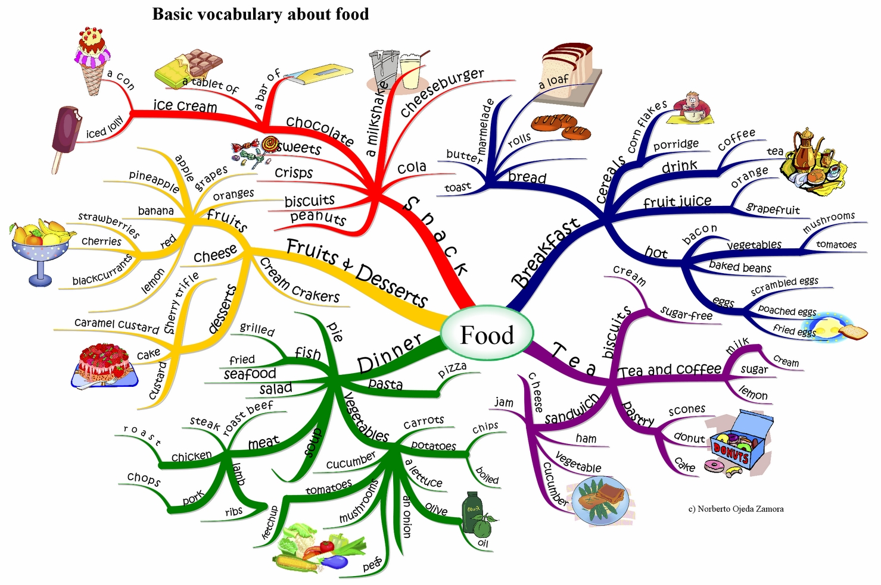
Vocabulary exercises.
A frequent lexical activity is lexical mind map.A mind map is the result of lexical associations with a key word.
‹#›

Slide 49
Vocabulary exercises.
Micro-teaching task
Design a three-phase framework for teaching vocabulary to describe the interior of a supermarket.
‹#›

Slide 50
Vocabulary exercises.
The while-activity task for the learners is: “Yesterday you were in the shop and lost your purse. You must have dropped it somewhere. Here is the picture of the shop (the picture is on the classroom board). The class will help you to remember where you might have lost your purse.
They will make guesses such as “under the counter”, “by the cash-register”, “in the cereal isle”, “in the tea-and-coffee isle”, “on the freezer with ice-cream”, “at the entrance”, “in the exit”, “on a trolley”, “on the shelf with peanut butter”, “on the shelf with canned food” etc. When the class makes the right guess, you say “Thanks. Now I remember!”
‹#›

Slide 51
Vocabulary exercises.
Integrated task
Clarify your purpose of teaching the vocabulary
Describe your teaching situation
Give a theoretical rationale for teaching vocabulary in your situation
Design a three-phase activity to teach the vocabulary
Produce a transcript of how the activity went on in class or with your peers
Reflect on the procedure
Draw conclusions.
‹#›

