Slide 1
Teaching pronunciation
Работу выполнили:
Студентки группы ИИЯ-АНБ-511
Авилова Анна
Афанасьева Анастасия
Любимова Светлана

Slide 2
The aim of this unit
To make you think about teaching English pronunciation
To get acquainted with the techniques of teaching pronunciation
To explore your own experience of running the techniques
What do you have to do in this unit?
Input reading
Exploratory tasks
Self-assessment questions
Micro-teaching tasks
Integrated task

Slide 3
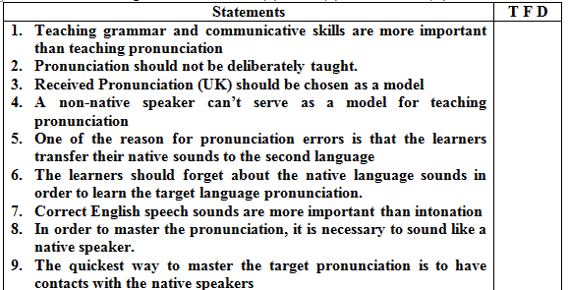
Warming up discussion
Mark the following statements as true (T), false (F) or debatable (D)

Slide 4
Input reading 1
General features of teaching pronunciation
Teaching pronunciation is important not just because it is necessary to communicate one’s ideas clearly.
Articulation movements accompany the process of using the language not only when a person is speaking but also during listening, reading and writing.
Hidden articulation movements were registered when a person seemed silent just listening to somebody else talking or when reading a text. The more difficult the cognitive task, the more obvious become sound articulations. Language articulation is thus closely linked to the language-and-thought processes. If the hidden articulation movements are suppressed (in experiments the subjects are asked to perform some movements with their tongue while doing a thinking task) the subjects find it difficult to perceive the words. Pronouncing one’s thoughts or at least making hidden articulations facilitates the process. People often resort to pronouncing words while reading a text when they find the text ambiguous.

Slide 5
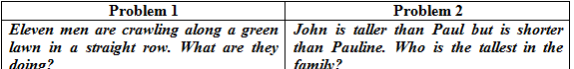
Exploratory task 1.1
The task is done by a pair of students. One attempts to solve silently the two verbal problems given below. The other observes the process and reports on the emergence of slight articulation movements. When and why does articulation appear?

Slide 6
Speech sound articulation is important not only to pronounce the words but also to recognize and to spell them.
Russian learners of English often mistake the [t] sound for [ch} sound, believing that the words <teacher> is pronounced as [chicher], and the structure <it is> is pronounced [ichis].
Mistakes in orthography can also be traced to erroneous pronunciation. In poorer learners of English the following words can be both pronounced and spelt erroneously: <headache> is pronounced and spelt as [hedach], <blood> as [blud], <type> as [tup] because <y> is associated with the Cyrillic letter and sound [oo], <climate> as [climat].

Slide 7
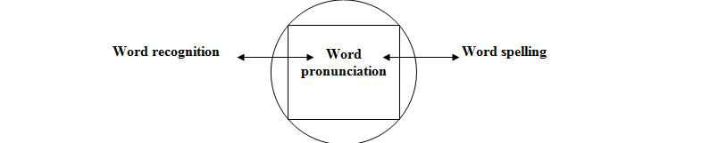
An interesting example of substituting a more familiar word for a less familiar one is <extinct>, which was both read and spelt by the learners as [instinct] (author’s data). . This dependence between word pronunciation, recognition and spelling is shown by the graph:

Slide 8
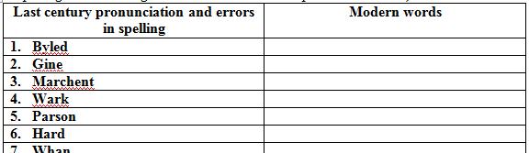
Exploratory task 1.2
Misspellings in informal private letters of the previous centuries can give us a cue about the way the words were pronounced in those times.
Try to guess what words were actually pronounced and spelt erroneously as shown in the left column. Write your guesses in the right column (the spelling has not changed since old times but the pronunciation has).

Slide 9
The communicative approach since 1980 holds that pronunciation is important for teaching the language for the purpose of communication.
The studies in the importance of sounds and intonation have shown that intonation appears to be more important for communication than speech sounds.
Mistakes in intonation cause more comprehension problems that mispronounced phonemes.
Mastering the pronunciation of a foreign language presents great difficulties for the learners. Russian learners of English can find it difficult to distinguish between the sounds in the words “bed” and “bad”. They can equally find it difficult to distinguish the sound in the words “ten” and “tan” etc. The reason for the difficulty is that Russian students of English do not have in their native tongue the distinction between open, half-open and closed vowels, as well as between short and long vowels (as in “bin” and “bean”) and monophthongs and diphthongs (as in “pen” and “pain”).

Slide 10
English rhythm and stress pattern of sentences are also hard to master for the Russian learners.
Russian speech is less rhythmical. Russian words do not have a primary and secondary stress. Russian learners of English are no exception in their difficulties.
Japanese students find it next to impossible to perceive the difference between “rice” and “lice”.
Thai students find English intonation confusing because in the Thai language the word “haa” said with the falling tone means “five”, while the same word pronounced with the rising tone means “to look for”.

Slide 11
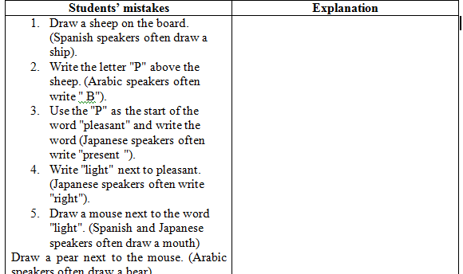
Exploratory task 1.3
Non-native speakers of English got the task to fullfil teacher’s commands such as to draw pictures or write words from dictation. They made mistakes in doing the task. How can you account for the mistakes made?

Slide 12
Possible reasons for the learners making errors in pronouncing the foreign sounds are that a particular sound may be absent in the mother tongue.
A sound may exist in the mother tongue but with a different articulation.
Similar native sounds may not distinguish the meaning as in the foreign language (e.g. long and short vowels).
Learners may mispronounce the sound because they may mishear it.
Conversely, the learners can mishear the sound because they mispronounce it. That is why the first thing needed to be done is to check that the learners can hear and identify the sounds that are to be taught.

Slide 13
After the learners have acquired the sound-symbol correspondence, they may in some languages immediately decode any given word or write down any spoken word without much hassle.
In the English language it is not so simple. This happens because in the English language the words have long changed their pronunciation but their original spelling still remains the same.
English orthographic system functions on the “conservative principle” while pronunciation appears to be more dynamic and changes with the time.

Slide 14
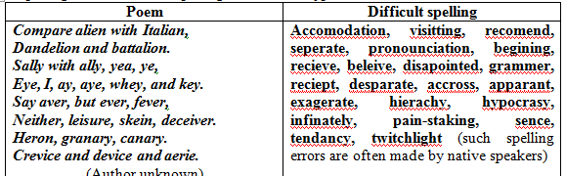
Exploratory task 1.4
In the left column check the pronunciation of words in the poem. In the right column check the spelling of words where spelling errors are so typical.

Slide 15
The goal of teaching pronunciation is not to make the learners sound like native speakers of English. Only few highly gifted and motivated individuals can achieve it.
A more realistic approach is to enable the learners to pronounce the language without detracting from the ability to comprehend the message.
This approach to teaching pronunciation is called approximating. The target of teaching pronunciation is to develop in learners phonetic competence, which is the knowledge of the English phonetic means such as phonemes, syllable formation, word stress and intonation.

Slide 16
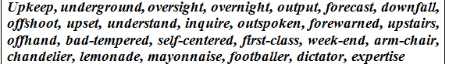
Exploratory task 1.5
Choose the right stress for the following verbs, nouns, adjectives and adverbs.

Slide 17
Phonetic competence includes the knowledge of how speech sounds (phonemes) are used in actual speech production.
This includes elisions (absence of sounds as in “Chris/t/mas”) and assimilation (where one sound merges in the next sound as in “hambag” standing for “handbag”). This is called “modification of phonemes in connected speech”.

Slide 18
There are some typical modifications of phonemes in connected oral speech.
If these words are spelt as they are pronounced they will look like: “GrapeBritain” (Great Britain), “stapement” (statement), “lasyear” (last year), “aspecs” (aspects), “cabnet” (cabinet), “libry” (library) etc.
One of the reasons that the phonemes merge together in oral speech is that it saves articulation efforts in speakers.

Slide 19
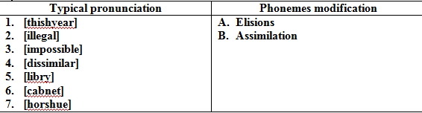
SAQ 1.1
Match the following types of pronouncing well known words and word combinations with the type of phonemes modification in connected speech.
Explain the articulation mechanism of these cases:

Slide 20
Merger of phonemes typical of conversational style can be found in the rap “Hello there now!” (pronounced rhythmically with four beats to a bar)
Hello there now,
Where’ve you bin?
I called roun’ta see ya,
Butcha never in!
Oh didn’tcha know
I’ve moved away?
I’ve gotta new job
Bin gone since May
Congratchulations!
That’s really great!
Hey, why do’ntcha
Come out an’ celebrate?
Terrific idea!
Let’s hit the town.
Dja know that new place –
The Rose ‘n’ Crown?
Yeah – see ya there
Bout half past eight.
Gotta get back now
Don’t wanna be late
I’ve gotta go too –
It’s nearly noon
We’ll have a lotta fun,
I’ll see ya soon.

Slide 21
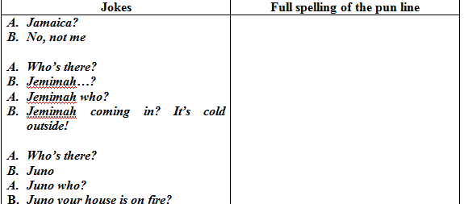
Exploratory task 1.6
There are English jokes that are based on modification of phonemes.
Read the following jokes and explain what produces the pun effect in them.
Give the standard spelling of the pun line (line that has a “word play” in it). Try to trace the path from the full pronunciation of the phrase to the reduced conversational style.

Slide 22
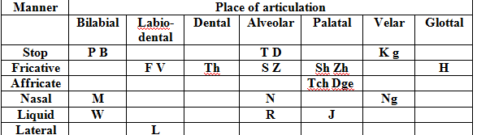
Major components of teaching pronunciation are English sounds and intonation. English consonants (24) are represented in the chart below:
These sounds make up the target in teaching English consonants

Slide 23
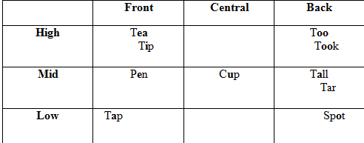
Vowel sounds can be distinguished from one another by which part of the tongue is involved (front, central, back) and by how high the tongue is when the sound is produced (high, mid, low).
These two dimensions are summarized in the vowel quadrant:

Slide 24
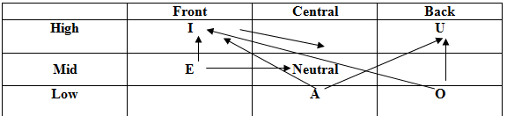
A typically English feature of the vowel system is the diphthongs or the vowel glides.
The vowel glide in the English diphthongs is shown in the quadrant below:
E.g. play, near, town, pair, time, tour, toy etc.

Slide 25
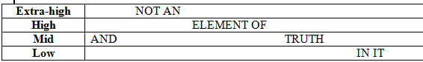
English intonation can be introduced to the learners as the variation of the voice pitch levels.
This can be compared to the variation on the music staff. The staff and an example sentence can be drawn as follows:
Major intonation tone groups are: low rise and low fall, high rise and high fall, fall-rise (within one syllable), rise-fall (within one syllable), fall + rise (within a series of syllables) and rise + fall (within a series of syllables), mid-level tone.

Slide 26
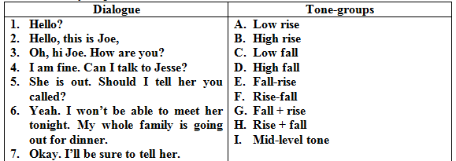
Exploratory task 1.7
Match the following phrases in the dialogue with the appropriate tone-groups.
Compare your results with your peers’:

Slide 27
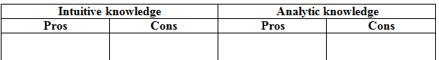
Input reading 2
Warming up discussion 2.1
There are two kinds of knowledge in mastering the English pronunciation.
One type of knowledge is intuitive, which is a language feeling.
The other type of knowledge is analytic and is based on the knowledge of articulation.. List all the “pros” and “cons” of the intuitive and analytic ways to teach English pronunciation

Slide 28
Techniques for teaching pronunciation
There are techniques for teaching pronunciation that have traditionally been used and are still being used in instructed settings.
The traditional approach to teaching pronunciation that still survives is the “pronunciation drill”.
Drills are still very popular and there are a number of reasons for that. Drills mean engaging the students in the narrowly defined tasks. This provides emotional security for the learners and teachers.

Slide 29
Drills are relatively easy to perform. They guarantee in most cases the immediate result of mastering the learning material.
In other words “drill works” and that is what matters. It is evident that one can’t master pronunciation of the foreign language without some form of repetitive drilling.
Repetition can be by the whole class, individually in the fixed order, slow tempo and fast tempo, repetition in small groups etc.

Slide 30
Listen and imitate
Students listen to the teacher provided models and repeat to imitate them. E.g.1: back, lack, lap, tap, map, cat, fat...(phoneme [a] in the closed syllable). E.g.2: Why Willie, why wink widely, weep wildly, whoop weirdly...? (every word begins with [w]).
Repetitious exercises train the learners to pronounce long chains of words and/or phrases. E.g. lunch, much, crunch, such, touch... At lunch I like to crunch so much and touch what I can crunch..
Analogy exercises consist in filling in the gaps in word chains on the analogy. E.g. My loved one is so near, and dear, but I ... (fear) that he will not come here.

Slide 31
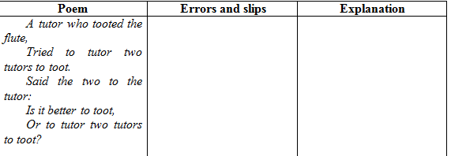
Exploratory task 2.1
Practice the rhyme given below and observe the errors and slips you and your peers have made.
Try to account for the errors and slips:

Slide 32
Exploratory task 2.2
Try to add more words into the dialogue to train the sound [au]. Give the text for imitation to the peers.
- I’ve found a mouse!
- Found a mouse? Don’t shout so loud! Sit down.
- I’ve found a brown mouse! A mouse running around in the lounge!
- On the ground?
- Under the couch!
- Get it out!
- How?
Somehow. Turn the couch upside-down. Wow! A mouse in the house!
Ours is the foulest house in the town?!
(words to insert: now, round, Brown, cow, ouch, clown, pounds, down, gown, sound, owl …).

Slide 33
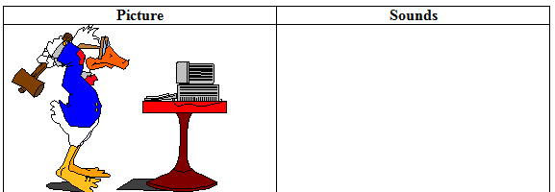
Exploratory task 2.3
Try the following activity with your students or peers and reflect on the procedure.
Show the learners a picture and ask them to pronounce all the sounds they need to describe it. The learners first pick out the necessary words, analyze the sounds that are used in these words and finally produce a list of the sounds necessary for the description of the picture.
After that they practice the sounds, pronounce the sounds in the words and finally describe the picture.

Slide 34
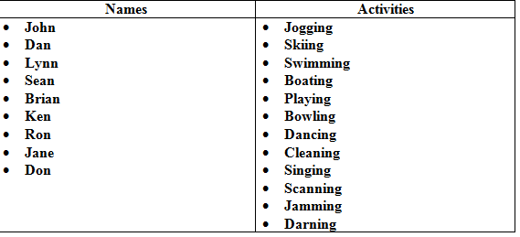
Minimal pair drills
The technique helps the students distinguish between similar sounds in the target language through listening discrimination.
Contrastive exercises train in learners the ability to distinguish the meaning with the help of phonemes. E.g. I feel that I have my...(fill). I can't go up the hill on high...(heel). There are too many sheep on such a small...(ship).
In order to make the minimal pair drill (e.g. /n/ VS /ng/) more communicative, pair work can be organized and the students are asked to ask each other questions using the list of names and activities. E.g. Where’s Ron? – He is running. Where’s John? – He is jogging.

Slide 35
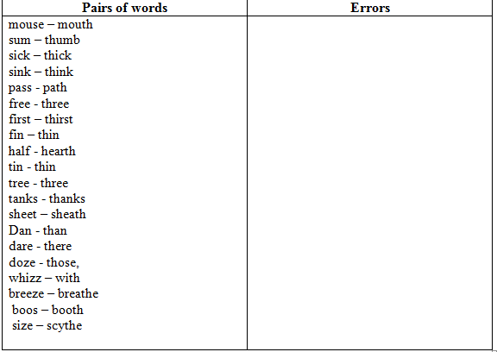
Exploratory task 2.4
Practice the following pairs of words.
Pronounce a word and make your partner decide on which word of the pair you actually pronounce.
Register all the errors in pronunciation and comprehension:

Slide 36
Tongue-twisters
Phrases that are difficult to say without a sound mistake because of the sounds interfering with each other.
E.g. “Swans swam in swarm and swiftly swerved to swallow the sweet worm” or “She sells sea shells on the sea shore and the shells she sells are sea shells”. Other examples are: The scythe of this size is the size of the scythe. This thin feather is thinner than that thick leather. Those pieces of leather and feather are both close with those clothes.

Slide 37
Exploratory task 2.5
Work out an activity to create tongue twisters of your own:
Write your full name, including any nicknames you may have:________________________________________
Now students work in groups of three. Dictionaries are okay!
Pass your paper to the person on your right.
Write one answer for every question you have received by passing each time your paper to other students. Your answer must begin with the first sound in the person's name (e.g. Mary - made a mess).
Continue doing this until all the blanks on all the papers are full. You should have different answers from all the people in your group when your paper comes back to you!

Slide 38
What did she/he do?_______________________
Where? ___________________________________
When? ___________________________________
Why? because _____________________________
Now use your paper to make funny tongue twister combinations. How many can you create? Which one is the funniest?
Example answers:
WHO: Mary
DID WHAT: met a man, ate mangoes, married a monkey
WHERE: in Minnesota, at the Market, in Montreal
WHEN: on May 5th, at midnight, in the middle of winter
WHY: because she was mad, by mistake, because her mother made her do it

Slide 39
Possible texts of the tongue twisters
Mary met a man at the market on May and her mother made her do it.
Mary married a monkey in Minnesota at midnight because she was mad.
Mary ate mangoes in Montreal in the middle of the morning by mistake.
Students can illustrate their best tongue twisters with or pin-ups for the class!
Contextual minimal pair drill. A situation setting is used to distinguish between the similar words. E.g. The situation is that a blacksmith is shoeing a horse. What sentence do you hear? “The blacksmith a/hits b/heats the horseshoe.
Visual aids. Devices such as charts, pictures, mirrors, real things are used to enhance the pronunciation training.

Slide 40
Developmental approximation drill. The technique reconstructs the way, in which children acquire pronunciation by substituting some sounds instead of the other. E.g. children acquiring English as their native tongue often substitute /w/ for /r/ or /y/ for /l/. In order to deal the this error, the exercise will take the following shape: wed – red, wag-rag, witch – rich, wipe – ripe, yet – let, yes – less etc.
Practice of shifts. E.g. /mime – mimic/, /photo – photography/. Rhythmic exercises develop rhythm of utterance: This thimble is thick for a thin finger. This thimble is thin for a thick finger. A thick thimble for a thick finger. A thin thimble for a thin finger. Thick for thick. Thin for thin.
Rhythm reinforcement may take the form of jazz chants. E.g. Where's the cat? - It's on the mat. - On the mat? - Yes, on the mat. - Why on the mat? - It's so fat, it can't stand and sat on the mat. Jazz chants are based on the repetition of phrases: Eat your salad! - I don't like it. I hate it. I loathe it...

Slide 41
Exploratory task 2.6
Shifts of stress can be practiced with the nursery rhymes that have a typical pattern or rhythm.
Could you think of the rhythm pattern to the rhyme below?
Mary, Mary,
Quite contrary
How does your garden grow?
With silver bells,
And cockle shells,
And pretty maids all in a row.

Slide 42
Exploratory task 2.7
In the rhyme that follows first try and produce the rhythmic pattern of your own (the given pattern should be masked) and then compare it with the one given to the right of the poem:
Little Jack Horner -..-.
Sat in a corner -..-.
Eating his Christmas pie -..-.-
He stuck in his thumb .-..-
And pulled out a plum .-..-
And said “What a good boy am I” ..--..-.-
Recitations. Passages are given to the learners for practice and recitation with the focus on stress, timing and intonation. This techniques may or may not involve memorization of the text.

Slide 43
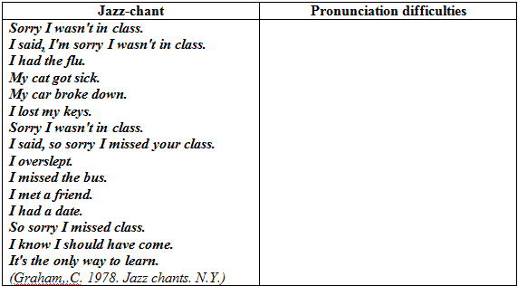
Exploratory task 2.8
Analyze the following “jazz-chant” and predict the phonetic difficulties it may cause:

Slide 44
Tasks with interjections
Tasks with interjections are used to develop in learners the ability to use phonetic means in the given situational circumstances.
There are quite a few phonemes that can be used in speech as “interjections” i.e. short exclamatory words. The learners are given a situational phrase, to which they react using an interjection with the correct articulation and intonation.

Slide 45
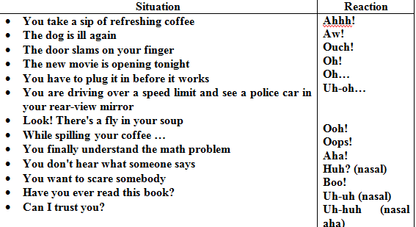
Exploratory task 2.9
React to the following situational phrases with an interjection.
Clarify the intonation and feeling you want to express.

Slide 46
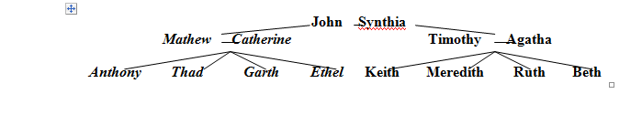
Creative exercises
These techniques incorporate phonetic tasks in the creative communicative task.
E.g. Make up a list of your favorite fruit and pronounce the words to make everybody feel how you like the items.
Make up a poem about the wind. End up every line with the sound /sh-sh-sh-o-o-o-w/.
Read a news story to others. Sound bored, indifferent, shocked, irritated, angry or pleased.
A creative activity can target the acquisition of a particular sound or a group of sounds.

Slide 47
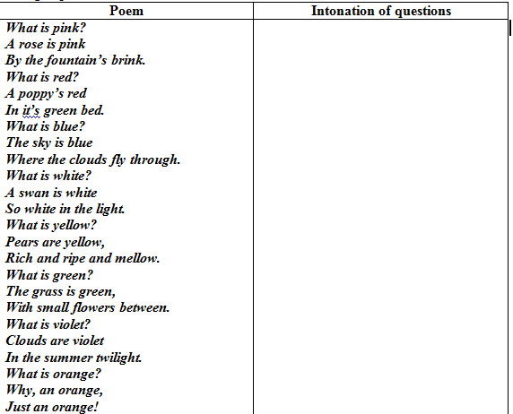
Exploratory task 2.10
Read the following poem and decide upon the intonation of questions (low rise, high rise etc) that you can use to make the poem sound better.
Recite the poem and compare your versions in the groups.
Recording of learners’ pronunciation offers opportunities for feedback from the teacher and peers.

Slide 48
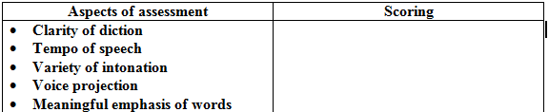
Exploratory task 2.11
Advertise the objects that are in front of you in order to convince the audience to buy them! You can advertise “a bag”, “a sandwich”, “a paper clip” etc.
Speak non-stop for three minutes. Your presentation will be recorded as well as the presentations of other students.
Decide which presentation is the most convincing and why. Give the scoring for the following:

Slide 49
Board game
Board games are used for teaching pronunciation in pairs or small groups.
They teach not only pronunciation but also learner interaction.

Slide 50
Exploratory task 2.12
Try the game rhyming dominoes.
In the game words are used instead of numbers. Each player chooses out of the set 5 or 7 dominoes.
The player with a double domino (having two rhyming words on it) starts the play. The next player continues by adding a domino, which has a word to rhyme.

Slide 51
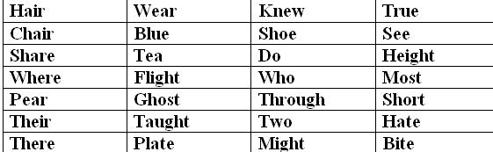
The game continues round the players and the first person to get rid of the cards is the winner.
Use the following grid for cutting the dominoes across or down:

Slide 52
Exploratory task 2.13
Guess the words. Every answer has the sound [tch] or [dge].
Famous English prime minister.
We eat bread, butter and … m
We buy jam in a …r
You’ll get fat if you eat too much …ate.
A game for two is …s.
A young hen is a …n
This rude man is not a … n
This dangerous bridge is …st outside the village.
Tell me a funny …e
His new car is a … eep
To buy meet let’s go to the …’s

Slide 53
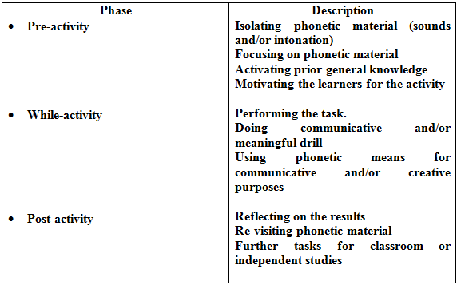
Three-phase framework for teaching pronunciation
The three phases for teaching pronunciation include pre-activity, while-activity and post-activity.
The general contents of these phases can be as given in the table below:

Slide 54
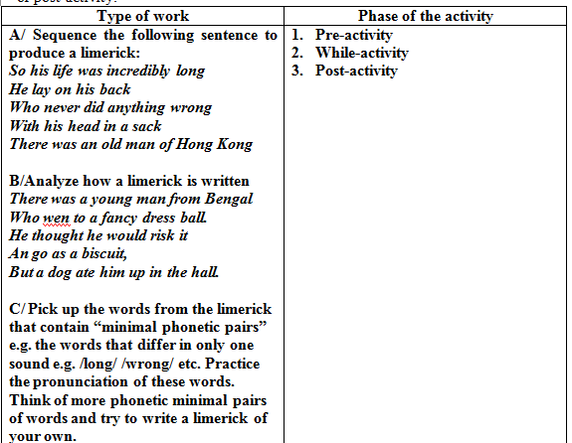
Exploratory task 2.14
Match the following stages of running the activity and the phases of pre-activity, while-activity or post-activity.

Slide 55
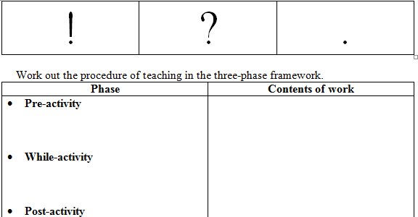
Micro-teaching task
You are to teach your learners the pronunciation of statements, questions and exclamations.
You are going to show them a set of pictures. By using these pictures you can elicit either statements, questions or exclamations. To signal your learners what kind of sentences you want them to produce, you will use the cards

Slide 56
Integrated task
Describe your teaching situation
Make concrete your goal of teaching pronunciation (e.g. pronunciation of certain sounds)
Give the theoretical rationale for teaching
Produce an activity in the three-phase framework
Run the activity
Reflect on the results giving examples from your observations while teaching
Draw conclusions on what can be improved in teaching

